Slide 1
Hi-Touch Healthcare
Notes:
Display as participants enter and explain that this training was developed and created based on industry and educator input in conjunction with the Health Workforce Initiative Statewide Advisory Committee, California Community Colleges Chancellor’s Office, and Workforce and Economic Development Program. This is just one soft skills module of the comprehensive training package: “Hi-Touch Healthcare: The Critical 6 Soft Skills.”

Slide 2
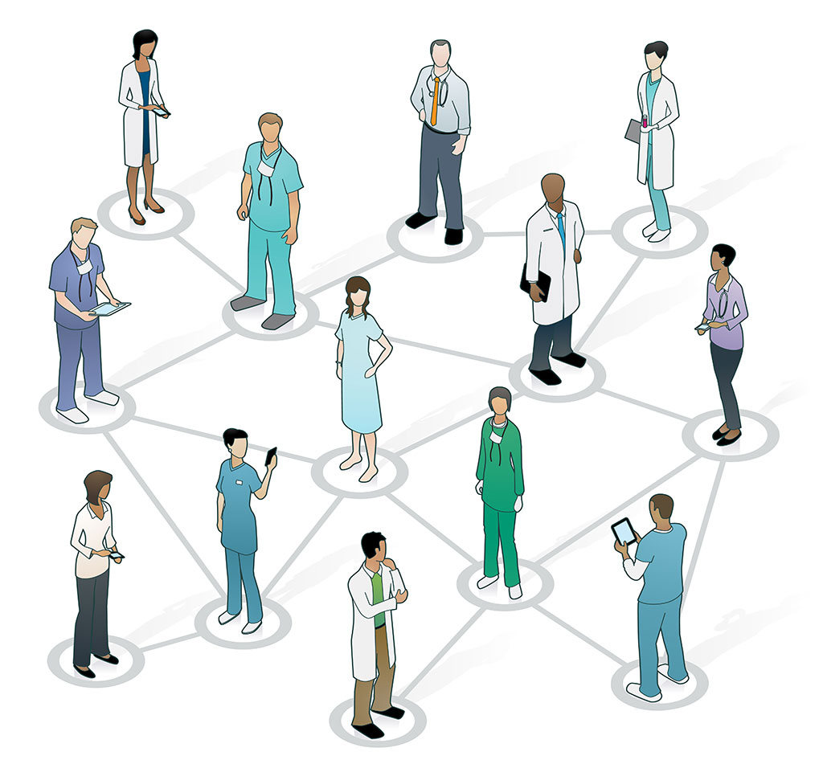
EMPATHY/CARING BEHAVIORS

Slide 3
What to Expect in this Presentation
Empathy Quiz
Definition of Empathy
Importance of Empathy in Healthcare
Empathy vs Sympathy
Building and Destroying Empathy
Triad Role Play Activity
Empathetic Communication
Tiffany and Fran Activity
Empathy Outcomes
Case Study Activity
Notes:
Quickly preview the session.

Slide 4
Importance of Communication and Soft Skills
“Communication is “the skill that can possibly have the greatest impact on effective healthcare delivery. It really is the key to clinical governance and demands as much attention, respect and sustaining as other seemingly ‘harder’ targets. However, often the mere mention of the importance of communication causes less than positive reactions in healthcare professionals.”
(Jelphs, 2006, senior fellow at the
Health Services Management
Centre at the University of Birmingham)
Notes:
Explain that dismissing the value of learning about how to be a more competent communicator is not peculiar to the healthcare field, but a result of the “hindsight bias” or the “I already knew that” phenomenon. The hindsight bias is a phenomenon in which people overestimate their prior knowledge. To demonstrate the concept ask the participants if they have watched TV shows such as Jeopardy, Are You Smarter Than a 5th Grader and/or Who Wants to Be a Millionaire. Remind them of the context in which music is playing while the question or answer is displayed WITHOUT the answer to the question, but when the answer is provided everyone comments, “I knew that.” The reality is that they did not know the answer, but seeing the answer rang true to their personal experience which resulted in an overestimation of their prior knowledge. Because we have been communicating our whole lives and we have communication competencies, it is easy for us to hear information about effective communication and think “I already know that,” but it is important not to fall prey to the hindsight bias or to discount the value of enhancing one’s communication competencies.

Slide 5
Empathy Quiz
I often think about other people’s feelings.
I don’t make fun of other people because I can imagine what it feels like to be in their shoes.
I listen to others when they share what they’re going through.
I try to understand other people’s point of view.
I am aware that not everyone reacts to situations the same way I do.
Notes:
(Animated Slide)
(See detailed procedures on page 4 of the Trainer Manual.)
Goal: This activity provides an opportunity for participants to examine themselves in regards to empathy. Participants will hopefully recognize that they have areas in which empathy can improve.
Procedures:
Have participants read the questions on the PowerPoint slide. The questions are as follows –
I often think about other people’s feelings.
I don’t make fun of people because I can imagine what it feels like to be in their shoes.
I listen to others when they share what they’re going through.
I try to understand other people’s point of view.
I am aware that not everyone reacts to situations the same way I do.
Have participants read each question and keep track of how many times they answer “yes” and how many times they answer “no.”
Explain that if participants answer “yes” to most of the questions they are on a good road toward being empathetic. If participants answer “no” to most of the questions, then they should pay particular attention to the module today.

Slide 6
EMPATHY DEFINITION
“Empathy is defined as the ability to understand a patient’s feelings, understand the situation from the patient’s perspective, and communicate this understanding to the patient.”
-American Nurses Association

Slide 7
WHY IS EMPATHY IMPORTANT IN HEALTHCARE
Patients are
Vulnerable
In a crisis
Away from home
Notes:
Explain that it is vital for healthcare professionals to empathize with their patients. Healthcare professionals have empathy in their hearts, but patients aren’t mind readers. Healthcare professionals must intentionally use empathic statements, such as, “I know this is very difficult for you.”
Might be good to elaborate here – even though the need for empathy might seem obvious, consider using information from the introduction of the training document. Help participants discuss WHY empathy is essential in healthcare situations.

Slide 8
EMPATHY = SYMPATHY ?
Empathy means to feel like another person
Sympathy means to feel sorry for another person.
Notes:
Explain that some people think that empathy and sympathy are the same thing. With empathy, healthcare professionals temporarily step into the patient’s shoes and internalize the patient’s struggles; on the other hand, sympathy means providing comfort but not identifying with the person’s specific challenges.

Slide 9
BUILDING EMPATHY
Things that help build empathy
Trust
Attentiveness
Appropriate responses
Shared experiences
Respect
Support
Notes:
Explain that there are several things that help build empathy.
Trust is crucial for building empathy.
Paying attention to the other person is important and so is responding appropriately.
Sharing challenging and positive experiences establishes a connection which builds empathy. Feeling supported goes along with this.
If possible, use references to the expanding body of research that investigates and supports the intentional cultivation of empathy.

Slide 10
Destroying empathy
Things that make it difficult to feel empathy towards another person
Inattentiveness
Lack of interest
Lack of respect
Notes:
Explain that empathy is quickly destroyed when someone is ignored and not made to feel important or respected.
How does a lack of or broken empathy negatively impact patient outcomes? Why?

Slide 11
Triad Activity
3 roles
Patient
Healthcare worker
Observer
Act out the situation
Debrief
Notes:
(See detailed procedures on page 5 of the Trainer Manual.)
Goal: This activity provides an opportunity for participants to either be in a position where they would benefit from empathy, be able to act with empathy, or give input for improved empathy.
Materials Needed:
Copies of the “Empathy Participant Instructions” (on page 6 of the Trainer Manual) -one copy per each group of three participants
Procedures:
Have participants form groups of three.
Hand out a set of “Empathy Participant Instructions” to each group.
Each participant is given a role to play – “Patient,” “Healthcare Worker,” or “Observer.”
Allow 3-5 minutes for each person to read the instructions describing his/her role.
After participants have read their roles, have them act out the situation.
Role Play.
After the participants have acted out the scenario, allow discussion where the observer reports out to the small group of three.
Small group discussion—reflect on the feedback from the observer.
Report out: Small groups report out to the large group. Discuss similarities/differences among the groups and how empathy can positively impact patient care outcomes.

Slide 12
EMPATHIZING WITH PATIENTS
What are they experiencing?
Connect
Notes:
Explain that no matter what our role, it is helpful when seeing patients to think about what they are experiencing. Too often healthcare workers can be focused on the “task” that needs to completed which makes it easy to forget that the patient is a human being, a person with emotions.
Except in the case of an emergency, it is essential to connect with the patient FIRST, then move on to the tasks and medical care that needs to be provided.
Think about what the person is experiencing and even say it out loud to the patient – “This must be overwhelming for you.”

Slide 13
Empathetic communication
Things we can do to build empathy in our communication
Stop talking
Ask questions
Using ”ah ha” and “umm hmm”
Eye contact
Welcoming body language
Hand on shoulder or hand
Notes:
Explain -
Stop talking – always remember that if you are talking then you are not listening. Which shows more empathy – talking or listening? Listening!!!
Asking questions shows interest and care
Using ah ha and umm hmm helps encourage communication and sharing
Maintain good eye contact – have you ever talked to someone that never looks at you? Do you feel like they care about you?
Display attentive and welcoming body language
Why do those behaviors impact patient outcomes? Again, I know it might seem obvious, but participants need to hear something beyond the obvious.

Slide 14
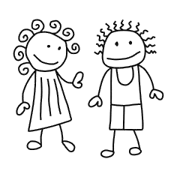
Tiffany and Fran Activity
Listen to the story, listening for empathy.
Notes:
(See detailed procedures on page 7 of the Trainer Manual.)
Goal: This activity provides an opportunity for participants to listen and observe an interaction between two friends and answer questions throughout the interaction to help understand and implement empathy.
Materials Needed:
Empathy Power Point Presentation slide 14 – 15
One copy for each participant of the “Tiffany and Fran Dialogue” (on pages 8-9 of the Trainer Manual)
Procedures:
Distribute copies of the “Tiffany and Fran Dialogue” to each participant.
Have three volunteers read the roles of Tiffany and Fran.
At the conclusion of the dialogue, ask the questions found on slide 15 of the Empathy Power Point.

Slide 15
Thoughts
What elements of empathy did you notice?
What impact did Fran’s empathy have on Tiffany?
How would you have reacted? Why?
Notes:
(Animated slide)
What elements of empathy did you notice? (Does not interrupt, give advice, change the subject to her own plans, does not disapprove, attentive to verbal and non-verbal cues, states understanding.)
What impact did Fran’s empathy have on Tiffany? (Appreciation for being listened to, increased trust in herself and Fran, feels hears, reduces distress, help understand her own feelings better, strengthened friendship.)
How would you have reacted? (Allow participants to express their reactions and do some self-evaluation and identify whys they could improve.)

Slide 16
COMMON MISTAKES
No time for empathy
Too “touchy feely”
Notes:
Explain the common mistakes:
No time for empathy – how long does it really take to say one sentence – 30 seconds! We should have 30 seconds.
Many healthcare professionals think that empathy is just a touchy feely subject without benefits. That is a mistake!
Why do they have that belief? Why is it a mistake?

Slide 17
Empathy Outcomes
Empathy
Trust
Compliance
Improved outcomes
Notes:
Explain that empathy enhances trust; trust enhances compliance. Compliance means that the patient follows the recommendations of the healthcare provider which means better clinical outcomes.
People follow the advice of those that they trust!

Slide 18
Case Study
A 70 year old man came to the ED with multiple health issues. A very friendly nurse asked about his medications. The patient became teary eyed and said, “My wife took care of my medications and she died two months ago.” The nurse, who was very nice, made no sympathetic or empathetic statements; the nurse just pressed the patient about the medications. The patient became agitated and said, “Don’t mess up my medications like the last time I was here!”
Notes:
(See detailed procedures on page 10 of the Trainer Manual.)
Goal: This activity provides an opportunity for participants to observe an interaction between a nurse and a patient and identify changes that can be made to increase empathy.
Procedures:
1. As a group, read the case study.
2. Ask the participants the following questions:
a. Was empathy used?
b. How could it have been handled differently?
c. What was the outcome for the patient?

Slide 19
Picture of Empathy Activity
Draw a picture of empathy
No limits
No rules
Share with the group
Explain picture
Notes:
(See detailed procedures on page 11 of the Trainer Manual.)
Goal: This activity provides an opportunity for participants to draw what their new vision of empathy and to explain this vision to the group.
Materials Needed:
Piece of paper for each participant
Drawing utensils (color crayons or colored pencils to share)
Procedures:
Distribute a piece of paper to each participant.
Allow a small group of participants to share a package of color crayons or colored pencils.
Instruct participants to take into consideration everything they have learned about empathy.
Draw a picture that represents empathy to them. There are no limits or rules. If some are hesitant – you may allow them to work in pairs.
Allow 5-10 minutes for the pictures to be drawn.
Ask for volunteers to show and explain their pictures.
Point out any aspects that participants included from today’s module.

Slide 20
“You never really understand another person until you consider things from their point of view – until you climb inside of their skin and walk around in it.”
-Harper Lee “To Kill a Mockingbird”

Slide 21
Optional Empathy Video
https://www.youtube.com/watch?v=cDDWvj_q-o8
Notes:
(See detailed procedures on page 12 of the Trainer Manual.)
Goal: This activity provides an opportunity for participants to watch empathy in action in a healthcare setting.
Materials Needed:
Equipment, including audio and video so that participants can see the video
Procedures:
Show the video
Allow for any comments from participants
Disclaimer – Some institutions have already used this video. Each situation and group will vary and will be up to the facilitator if they chose to show it.

Slide 22
Thank you!
Questions?
Comments?

