Slide 1
Hi-Touch Healthcare
Notes:
Display as participants enter and explain that this training was developed and created based on industry and educator input in conjunction with the Health Workforce Initiative Statewide Advisory Committee, California Community Colleges Chancellor’s Office, and Workforce and Economic Development Program. This is just one soft skills module of the comprehensive training package: “Hi-Touch Healthcare: The Critical 6 Soft Skills.”

Slide 2
The 4 A’s:
Attendance, Appearance, Aesthetics and Accountability

Slide 3
WHAT TO EXPECT IN THIS PRESENTATION
Professional Standards
Overview of the 4 A’s
Professionalism and the 4 A’s
Activity #1: Stressed for Success
Activity #2: Dress Code: Old and New Concept Map
Activity #3: Ball Juggle
Activity #4: Not Your Ordinary Sand Castle
Notes:
Quickly preview the session

Slide 4
The 4 A’s, Professional Standards, and Professionalism
Professional standards can be defined as “the skill, competence, or character expected of a member of a highly trained profession.”
(Encarta English Dictionary, North America 2016)
Professionalism – a manner in which an individual performs in their place of employment.
Notes:
Read definition of professional standards and professionalism. Then explain that the 4 A’s of attendance, appearance, aesthetics, and accountability can all be considered professional standards and that employees who adhere to these professional standards are considered “professional.”

Slide 5
The 4 A’s
Attendance
Absenteeism disrupts the working environment and can negatively impact employee morale, costs, and the continuity and quality of patient care (Nursing Economics, 2001).
Notes:
Read slide and describe a typical day at work when one or two people call in sick. How does it make them feel? Morale goes down, frustration goes up at the increased workload on others, and job dissatisfaction can occur.

Slide 6
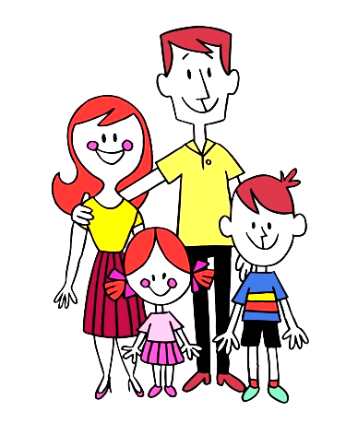
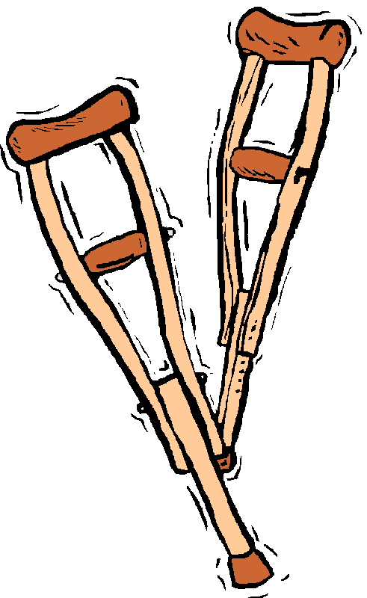
Absenteeism (Nursing Economics, 2001)
Causes for absenteeism:
Sickness
Family responsibilities
Scheduling issues
Occupational injury and illness
Dissatisfaction with the job
Job stress
Notes:
Read the reasons for absenteeism. Have participants raise their hand if they have ever called in sick for any of these reasons. Discuss each cause, one at a time.

Slide 7
Absenteeism
Possible Solutions
Stress reduction programs in the workplace
Meditation or “quiet” rooms for breaks
Discounts to gym memberships
Group educational classes about methods for stress reduction
Notes:
Read each bullet on the slide and ask if they think these would be helpful in their workplace. Why?

Slide 8
Absenteeism
Possible Solutions
Positive absentee-control programs - these offer a reward or positive motivation for good attendance
Personal and/or public recognition
Buy back of unused sick leave
Bonus payments for exemplary attendance
Notes:
Read each bullet on the slide and ask if they think these would be helpful in their workplace. Why?

Slide 9
Absenteeism
Possible Solutions
Develop a sense of unity, dedication, pride and commitment to the place of employment
Involve employees in decision making for the organization
Social events such as annual family BBQ’s
Community health fair that involves employees representing the organization
Notes:
Read each bullet on the slide and ask if they think these would be helpful in their place of work.

Slide 10
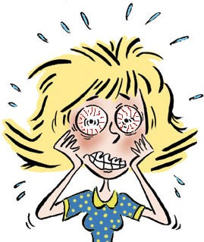
Activity #1 Stressed for Success
Let’s discuss stressors at home or work that can affect the work environment
Notes:
(See detailed procedures on page 5 of the Trainer Manual that accompanies this PowerPoint.)
Goal: This activity will provide an opportunity for patients to discuss issues that cause stress at home or work and to examine how this stress affects the healthcare work environment. In addition, methods that can be used for stress reduction will be offered.
Materials Needed (Quantities vary by how many in the group):
Butcher paper of other poster size material
Marking pens
Procedures:
Tell participants to form groups of three people per group.
Give each group a piece of paper, along with marking pen.
Have each group make two columns on their paper. Write at the top of the left hand column “Stressors I know” (work and/or home), and on the right hand column “My Secrets for Successful Coping.”
Allow the groups about 10 minutes to discuss and fill out their papers.
Call the groups back together and have a representative from each group share their information (5-10 minutes).
Topics for discussion:
Were there any similarities?
Were there any glaring differences? If so, why?
Explain we can learn from each other about how to reduce stress in the workplace and that we should also be able to recognize our stressors.

Slide 11
Other Things to Think About
Notes:
Read this supplemental slide to look at other things to think about when learning how to reduce stress.

Slide 12
Appearance and Aesthetics
Appropriate appearance and aesthetics (a sense of pleasant appearance) depicts professionalism and commitment to your place of employment and your role within that environment.
Shows pride in your
work and in yourself.
Notes:
Read the slide and then ask the participants if they have ever experienced going to a doctor’s office, clinic ,or other health care facility where they saw someone that worked there that was dressed shabbily, with unkempt hair, and perhaps had body odor? How did that make them feel? Did they lose any respect for the facility?

Slide 13
Appearance and Aesthetics
Things to Keep in Mind
Clean and non-wrinkled clothing
Clean shoes
Clean and neat hair
Minimal jewelry
Minimal (if any) perfumes or colognes
Visible tattoos should not be in poor taste
Notes:
Start by saying that this slide seems obvious, but remember back to your thoughts of someone unkempt at a healthcare facility?

Slide 14
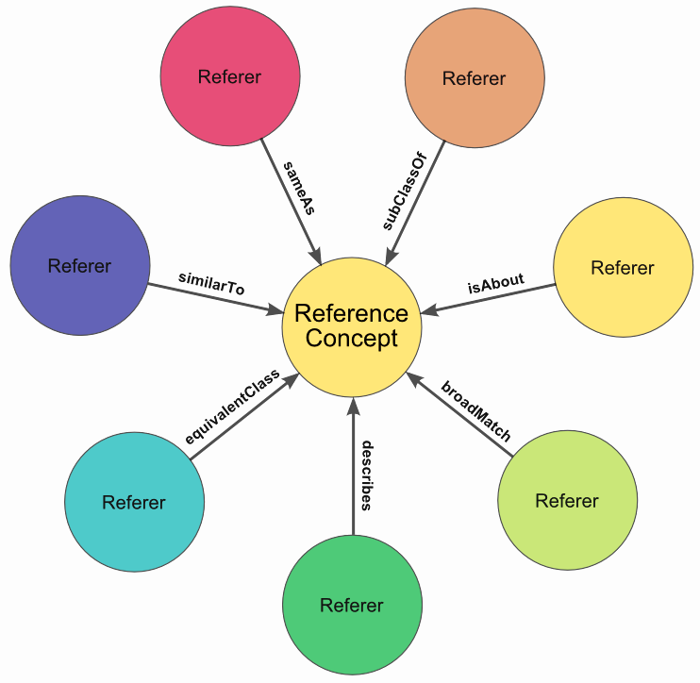
Notes:
Explain the example of a concept map.

Slide 15
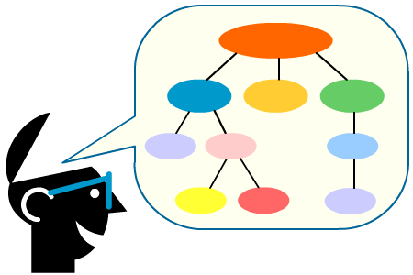
Concept Map Definition
A concept map is a type of graphic organizer used to help students organize and represent knowledge of a subject. Concept maps begin with a main idea (or concept) and then branch out to show how that main idea can be broken down into specific topics.
http://www.inspiration.com/visual-learning/concept-mapping
Notes:
Leave this slide up while participants are drawing and discussing their concept maps.
After their concept maps are completed, have each group discuss their thoughts about how dress codes have changed over the years. What about the future? Have some fun discussing what the future may hold for dress codes.

Slide 16
Activity #2 Dress Code Old and New
Let’s look back at dress codes from the past, and what they look like now!!
Notes:
(See detailed procedures on page 6 of the Trainer Manual that accompanies this PowerPoint.)
Once the activity has been explained and groups begin their work, return to slide 15 and display the definition of a concept map.
Goal: To understand differences that have evolved over the years in regards to dress code and acceptable appearance in the health care setting and what “acceptable” appearance may look like in the future.
Note to Trainer: Definition of Concept Map – “A concept map is a type of graphic organizer used to help students organize and represent knowledge of a subject. Concept maps begin with a main idea (or concept) placed in the center of the paper. The main idea can be described in words, images, or symbols. Branching out from the center, connecting ideas are then listed, again using words, images, or symbols.” ^{vii}
Encourage creativity: use words, pictures, arrows connecting concepts, etc. Materials Needed:
Copies of current Dress Code—one copy for each group. Note to trainer: Ideally, you will find the current Dress Code/Appearance Policy from the facility in which participants are employed. If this policy is not available, simply pull a sample off the internet.
Copies of old dress code (at least ten-years old)—one copy for each group. Note to trainer: Ideally, you will find the old dress code/appearance policy from the facility in which participants are employed. If this policy is not available, simply pull a sample off the internet. Or, have participants describe what they remember or envision the old policy was.
Butcher paper or other poster size material on which to draw the Concept Map.
Marking Pens
Procedures:
Tell participants to form groups of three to four per group.
Give each group pens and paper.
Depending on size of paper, either have groups use three separate sheets or one large sheet divided into three sections. Instruct participants to compare the new and old policies. For each policy, groups should list words or brief sentences that describe how they feel about each policy. Using those words/sentences, groups should create two concept maps—one for the current policy and one for the old policy.
Imagine: Have the groups envision what the dress code will look like in the next 10-20 years. Have groups create a concept map representing what they think the “ideal dress code and appearance policy” will/should be. Encourage groups to have fun with this task!
After the concept maps are completed, bring the groups back together as a whole and have a representative from each group briefly talk about what they discovered.
Ideas for discussion:
What overlaps appear across the concept maps for the current policy? What impressions do the concept maps give (constrained/forced, approved/supported, conflicted)? What are the implications of these feelings/impressions of current policies?
What overlaps appear across the concept maps for the old policy? What impressions do the concept maps give (nostalgic, grateful, surprised, supportive, conflicted)? What are the implications of these feelings/impressions of previous policies? What insight can be gained by comparing old and current policies?
What overlaps appear across the concept maps for the future policies? What impressions do the concept maps give about the importance of professional dress codes? What do these impressions reveal about current requirements?
What do you think about the change from the traditionally white formal attire caused any shifts in how perceived credibility is today (with multicolored scrubs and flashy shoes)?

Slide 17
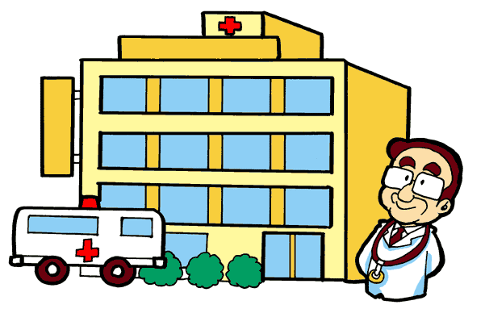
Accountability
Accountable
The act of being responsible or subject to obligation. (Denis, 2014)
Accountability to:
Patients
Families
Co-workers
Employer
Themselves
Notes:
Read the definition of accountability.
Discuss that all healthcare workers are accountable to their patients and their families, their co-workers, and their employer. Discuss accountability to oneself… consistently doing the right thing (even when nobody is watching).
The following activity allows participants to understand the importance of being responsible to each other as co-workers, and that every member of the team must be a part of the team for the smooth running of a healthcare facility to occur.

Slide 18
Activity #3 Ball Juggle
Notes:
(See detailed procedures on page 8 of the Trainer Manual that accompanies this PowerPoint.)
Goal: This activity allows participants to embrace opportunities to contribute to the work environment. Emphasis is on being helpful, accountable, and reliable to each other and to respect the contribution each team member brings to their team.
Materials Needed:
Soft, easily thrown balls (one for each participant)
Procedures:
Have the participants form a circle.
Give one ball to one participant in the group.
Instruct them to toss the ball to anyone in the group except for the person next to them. Continue the process until everyone has caught and tossed the ball at least one time.
Once everyone has caught and thrown the ball, begin introducing new balls about every 20 seconds to someone without a ball and have them toss the ball to someone else.
Tell them that the goal is to keep all of the balls in the air.
Keep introducing a ball until all the balls are distributed and they begin dropping balls frequently.
Stop the exercise and have everyone come up with a plan to keep all the balls moving and all the balls in the air at the same time.
Allow them to come up with the plan and begin the exercise again. Prompting to begin may be necessary.
Reflect: At the conclusion of this exercise, have everyone give each other a round of applause and then discuss the following topics:
How did the group do in demonstrating responsibility and accountability to all members of the team as they tried to juggle the balls?
How does this relate to their work environment?
How did the group work as a team? (Did they all “eagerly” participate?
How did management of the activity go? (Did anyone that “take over” or was there any “argument” about how to manage all of the balls?)

Slide 19
Accomplishing Accountability (Denis, 2014)
Three elements of accountability:
A clear definition of desirable goals and objectives must be established.
The ability to measure goal achievement must be developed.
A set of consequences must be established if those goals are not met.
Notes:
Read the three elements.
State that if these guidelines are followed, evaluated, and re-evaluated on a regular basis, accountability will become the normal and desired culture in the workplace.

Slide 20
Activity #4 Not Your Ordinary Sand Castle
Notes:
(See detailed procedures on page 9 of the Trainer Manual that accompanies this PowerPoint.)
Goal: This activity helps participants understand the idea of collective or shared responsibility and accountability and how irresponsible behavior or lack of accountability can lead to consequences that can affect the entire community or place of employment.
Materials Needed:
Copies of the handout “Not Your Ordinary Sand Castle”—one for each participant
Procedures:
Organize participants into groups of four.
Give a copy of the handout to each participant.
Read the story out loud to the group as they follow along.
Once the story is concluded, have each group discuss the story.
Topics for Discussion:
What does this story have to do with responsibility and accountability?
Relate this story to a recent policy change that has occurred in the facility in which they work. Ask the questions:
“What would happen if 50% of the employees reacted to the policy change like the first little boy that began kicking the castle?”
“How can you as an employee encourage acceptance and shared responsibility for the implementation of this new policy?”
“Have you ever behaved like the boy who kicked the castle?”
Report out: After the small-group discussion has been completed, have participants return to the whole group to share highlights from their small group discussion.

Slide 21
Thank You!!!
Questions?
Comments?

