Slide 1
Hi-Touch Healthcare
Notes:
Display as participants enter and explain that this training was developed and created based on industry and educator input in conjunction with the Health Workforce Initiative Statewide Advisory Committee, California Community Colleges Chancellor’s Office, and Workforce and Economic Development Program. This is just one soft skills module of the comprehensive training package: “Hi-Touch Healthcare: The Critical 6 Soft Skills.”

Slide 2
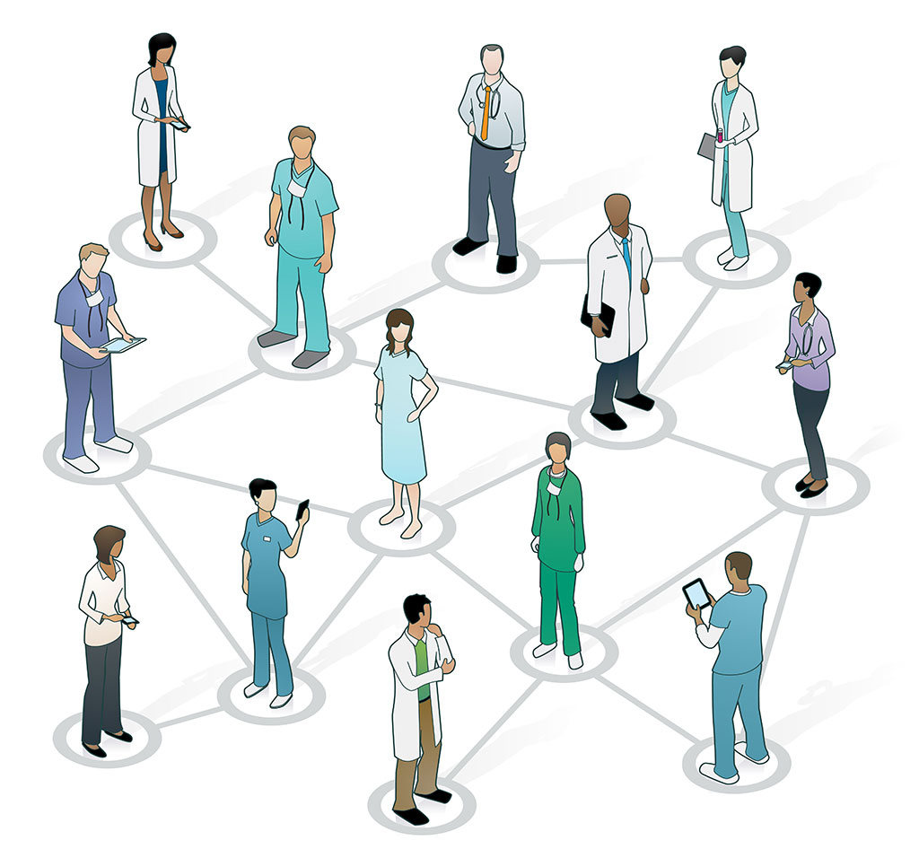
Ethics in healthcare and hipAa

Slide 3
What to Expect in this Presentation
Ranking Professions
Definition and factors affecting ethics
Activity: Ethical Donuts
Types of Ethical Dilemmas
Activity: Thought Shower
Core Principles of Ethics
Activity: Head or Heart
Notes:
Quickly preview the session.

Slide 4
Importance of Communication and Soft Skills
Communication is “the skill that can possibly have the greatest impact on effective healthcare delivery. It really is the key to clinical governance and demands as much attention, respect and sustaining as other seemingly ‘harder’ targets. However, often the mere mention of the importance of communication causes less than positive reactions in healthcare professionals.”
(Jelphs, 2006, senior fellow at the
Health Services Management
Centre at the University of Birmingham)
Notes:
Explain that dismissing the value of learning about how to be a more competent communicator is not peculiar to the healthcare field, but a result of the “hindsight bias” or the “I already knew that” phenomenon. The hindsight bias is a phenomenon in which people overestimate their prior knowledge. To demonstrate the concept ask the participants if they have watched TV shows such as Jeopardy, Are You Smarter Than a 5th Grader and/or Who Wants to Be a Millionaire. Remind them of the context in which music is playing while the question or answer is displayed WITHOUT the answer to the question, but when the answer is provided everyone comments, “I knew that.” The reality is that they did not know the answer, but seeing the answer rang true to their personal experience which resulted in an overestimation of their prior knowledge. Because we have been communicating our whole lives and we have communication competencies, it is easy for us to hear information about effective communication and think “I already know that,” but it is important not to fall prey to the hindsight bias or to discount the value of enhancing one’s communication competencies.

Slide 5
Ranking Professions By Level of Trust
Teacher
Clergy
Physician
Nurse
Attorney
Car Salesman
Notes:
(See detailed procedures on page 5 of the Trainer Manual.)
Goal: To help participants explore factors that influence individual conceptions of trust.
Materials Needed (quantities vary by group size)
Blank piece of paper for each participant
Pen or pencil for each participant
Procedures:
Give each person a piece of paper and a pencil/pen.
Using this slide, have participants rank the listed professions in order of most trust to least trust.
Pair: Have participants pair up and compare lists. Discuss what beliefs, stereotypes, and personal experiences may have influenced the chosen order of each participant. What does the ranking process reveal about each participant’s conception of trust?
Square: Group participants into two groups of pairs (four participants). Compare and explain why they chose their particular order of professions. What trends or patterns are revealed about the ranking process? What do these trends/patterns reveal about the conception of trust?
Report out: Have one participant from each group report an outstanding reason of why the professions were ranked in a particular order or what the group learned about where the idea of trust may develop.

Slide 6
Definition of Ethics
“Ethics is concerned with moral principles, values, and standards of conduct.” -World Health Organization, 2016
What does that mean to me? A set of moral principles, beliefs, and values that guide each person in making choices about medical care.
Notes:
(Animated Slide - each definition comes in separately.)
Explain that when ethics is discussed, rarely is there only one answer and rarely is it comfortable. Ethics is the study of right and wrong conduct. Ethics focuses on moral situations where this is a choice of behavior involving human values.

Slide 7
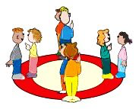
Activity: Ethical Donut
Form 2 circles, one inside the other
Participants should be facing each other
You will be given 1 minute to dialogue about the topic given to you
Outer circle will shift clockwise two people
Dialogue again
Repeat
Notes:
(See detailed procedures on page 6 of the Trainer Manual).
Goal: To help participants articulate their position on a variety of ethical dilemmas and hear other points of view without triggering debate.
Materials Needed:
An area large enough to for two circles, one inside the other
Procedures:
Have participants make two circles with pairs facing each other. The pairs will dialogue for 1 minute on a question listed below then the outer circle will shift clockwise two people so that new pairs are formed again. The inner circle remains as is and does not move. After discussion of the next question, the out circle will again rotate two spots clockwise while the inner circle does not move. Repeat a third and fourth time if time permits.
One minute discussion topics: Moral question ideas (Trainer--pick questions based on your audience and goals, or, create questions that work for your own training needs):
Do animals have rights?
Should we experiment on animals?
Should we place a limit on how many children a couple can have?
Should sex selection be allowed so parents can pick male or female children?
How would you solve the food shortage problem in the world?

Slide 8
Factors that influence
Family
Friends
Religion
Geography
School
Income
Occupation
Notes:
(Animated Slide)
Explain that we each have a little bit of a different view on what is right and what is wrong. Not on big things like robbing a bank, but on smaller things like whether it’s okay to taste one grape before we buy a bag of grapes at the grocery store.
Ask – What cultural and social factors do you think influence our ethics?
(Allow participants to answer, and then show the list.)

Slide 9
Types of Ethical Dilemmas
No absolute right or wrong answer
Both sides have merit
Outside the scope of the written law
Notes:
(Animated Slide)
No absolute right or wrong answer.
At what age does human life begin?
Both sides have merit:
A patient has a STD which he wants to keep confidential. His wife is a friend of yours. What do you do?
Outside the scope of the written law:
A woman serves as a surrogate, with the egg and sperm coming from the biological couple. During labor, the surrogate mother decides she wants to keep the newborn.
Does it matter if the egg belongs to the surrogate?

Slide 10
Activity: Thought shower
Divide into groups of no more than 5
Each group meets at a piece of paper
Each group has a different color pen
Write as many ideas as possible about how to improve the challenge situation that is read
Notes:
(See detailed procedures on page 7 of the Trainer Manual.)
Goal: To allow participants to see gaps in their own thinking as well as the thinking of their peers.
Materials Needed:
Large piece of poster board or paper for each group of five participants
A different colored writing utensil for each group
Planning Note: Have the poster boards either lying on tables spread out throughout the room or hanging on the walls throughout the room.
Procedures:
Hang a large piece of paper or poster board on the wall or place on a tables throughout the room.
Have participants divide into groups of no more than five and meet by a piece of paper.
Provide a different color pen for each group.
Explain that a challenging situation will be stated and that participants should then write down as many ideas as possible about how to improve the challenging situation.
No judgement zone: Remind participants that any and all ideas should be written down without fear of judgement.
Read one of the following situations or make one up that better fits the group or your training purpose. Sample situations are listed immediately following directions for this activity.
After 5 minutes of brainstorming, announce “change” and have the groups move to a different group’s paper.
Ask the group to add ideas to the previous group’s poster.
After 5 minutes, announce “change” and have the groups change again with the same purpose.
Do the changing as many times as time allows or until each group has visited all posters.
As a conclusion review trends and patterns and look for factors that influenced their ideas.

Slide 11
Core Principles of Ethics
Autonomy – to honor the patient’s right to make his/her own decisions:
Teach people to be able to make their own choices
Support their own choices
Do not force or coerce patient to do things
Notes:
(Animated Slide)
Explain that autonomy becomes complicated when the capacity of the patient to think, decide, and take action are diminished. At what point is the patient not competent? Further explain that when the patient and the healthcare worker’s views are not the same.

Slide 12
Core Principles of Ethics
Beneficence – to help the patient advance his/her own good
Our actions should benefit patients, as defined by the patient, not what we think
Create a sane and supportive environment
Act on behalf of vulnerable patients
Notes:
(Animated Slide)
Explain that beneficence - Is the patient’s good your only concern as a healthcare worker? What about your own values? The concerns of the spouse, children, or the recipient of organ donation?

Slide 13
Core Principles of Ethics
Nonmaleficence – to do no harm
Do not cause pain or suffering
Do not deprive patients
Do not kill
Notes:
(Animated Slide)
Explain that nonmaleficence – Do we as healthcare workers always know what is best and what won’t harm the patient?

Slide 14
Core Principles of Ethics
Autonomy – to honor the patient’s right to make his/her own decisions
Beneficence – to help the patient advance his/her own good
Nonmaleficence – to do no harm
Justice – to be fair and treat all cases alike
Act in a non-discriminatory and non-judgemental way
Respect patient’s rights
Notes:
(Animated Slide)
Explain that justice: This sometimes goes against human nature. Are you more willing to go out of your way for some patients and not others?

Slide 15
Modern Healthcare and Ethics
Ethics has become more of an issue because of -
Increased technology
Increased scope of educated
Prolonged lifespan

Slide 16
Activity: Head or Heart Ethical Case – “What about Thomas”
Notes:
(See detailed procedures on page 9 of the Trainer Manual.)
Goal: To help participants evaluate themselves to determine whether they are answering ethical dilemmas with their head or with their heart. The point of this exercise is to help participants examine and determine their ability to avoid emotional reactions and to intentionally use ethical principles to guide their interactions.
Materials Needed:
The slides in the PowerPoint that present the case
Procedures:
Present the case on PowerPoint Slides 16 -21.
Slide 22 gives instructions for the participants.
Caution – don’t let this turn into a debate about who is right and who is wrong. Remind the participants that this is an exercise in self-discovery of how they make decisions.
Present the ten questions on Slides 23 -26.
Close by asking the following questions –
Was your answer the same whether you answered with your head or with your heart?
Could you differentiate between making a decision with your head vs your heart?
When was it hard to keep your heart of the decision at hand?

Slide 17
Cast of Characters
Dr. Fisher – Pediatrician; developed a new procedure that has an 89% survival rate for extremely low birth weight baby (< 1 lb) costing $450,000 per baby
Joy Smith – Mother, still smoking and drinking socially, plans to go back to work after the birth of the baby
Michael Smith – Father, family just bought a new home, works a lot of overtime
Notes:
(Animated slide)

Slide 18
Cast of Characters
Emily Smith – Daughter,15; in band, drama, trying out for cheerleading, has lots of toys and wants to go to a private college
Dennis Copper – Owner of electronics company that Michael works at, needs to decrease amount of overtime worked by employees to have company sustain itself
Joseph Sullivan – CEO of Mega Health Insurance company, profits have been decreasing, has increased number of procedures not covered
Notes:
(Animated slide)

Slide 19
The Case
Joy goes into premature labor, has baby boy – Thomas. He weighs 15oz at birth.
Parents are informed about Dr. Fisher’s procedure.
Hospital policy on high cost procedures: procedure authorized only when covered by medical insurance or if parents agree to full financial responsibility.
Notes:
(Animated slide)

Slide 20
The Case
Without the procedure, Thomas will be put in the Newborn ICU, where his chances for survival are very small.
Father contacts insurance company and finds out that only $150,000 of the $450,000 will be covered.
Parents need to come up with $300,000.
Also, even if Thomas does survive, the chance if him being normal and healthy is <50%.
Notes:
(Animated slide)

Slide 21
The Case
Smith’s total savings is $20,000.
Smith’s have a rich family member that can help them get a loan for the remaining $280,000.
Smith’s decide to involve Emily in the decision.
Drastic changes will be required in the Smith house – move to a less expensive home, Emily will have to pay for her own activities and college, mom will need to go to work as soon as possible.
Dad needs to see if boss will let him continue to work overtime.
Notes:
(Animated slide)

Slide 22
Activity: Head or Heart
Series of questions
If you answer with your heart (emotional reason) then put your right hand on your heart
If you answer with your head (rational reason), then put your left hand on your head
Notes:
(There will be 10 questions presented. The point of this exercise is to help participants examine and determine their ability to avoid emotional reactions and to intentionally use ethical principles to guide their interactions.)

Slide 23
Questions
Is it ethical for a hospital to provide a technically feasible treatment only to those who can pay for it?
Under the circumstances described, should Mega Insurance be required to pay for the procedure?
Should everyone have medical insurance or should better policies be available to those who can afford them?
Is it fair for the Smiths to ask Emily help make the decision?
Notes:
(Animated slide)

Slide 24
Questions
If you were the Smiths, what decision would you make?
If the treatment could provide a 100% guarantee of Thomas surviving and being healthy, would your answer to any of the questions be different?
When the Smiths make their decision, should they take into account how they would feel if they agreed to pay for the treatment and then Thomas either died or became severely handicapped?
Notes:
(Animated slide)

Slide 25
Additional Questions
Some obstetricians will not make a great effort to resuscitate a severely handicapped newborn infant that experiences a cardiac arrest. Do you think this is ethical?
Would it ever be ethical to withdraw treatment from an infant with a poor chance of survival in order to provide intensive care for an infant with greater chances of survival?
Notes:
(Animated slide)

Slide 26
Additional Questions
Wrongful life lawsuits brought against hospitals, doctors, and even parents involve a claim that a severely handicapped child’s life is worse than death. What is your opinion about such lawsuits?
Notes:
Report out –
Was your answer the same whether you answered with your head or your heart?
Could you differentiate between making a decision with your head vs your heart?
When was it hard to keep your heart out of the decision at hand?

Slide 27
HIPAA Reminder
HIPAA does the following –
Provides the ability to transfer and continue health insurance coverage for workers and their families when they change or lose their job
Reduces healthcare fraud and abuse
Mandates industry wide standards for healthcare information on electronic billing and other processes
Requires the protection and confidential handling of protected health information
Notes:
(Animated slide)
Explain that HIPPA stands for Health Insurance Accountability Act that was passed by Congress in 1996.
Then review the 4 bullets on the slide.
(Give the HIPAA quiz provided on pages 12-13 of the Trainer Manual.)
(Please see module titled Social Media and Technology for more training regarding HIPAA.)

Slide 28
Thank you!
Questions?
Comments?

