Slide 1
Hi-Touch Healthcare
Notes:
Display as participants enter and explain that this training was developed and created based on industry and educator input in conjunction with the Health Workforce Initiative Statewide Advisory Committee, California Community Colleges Chancellor’s Office, and Workforce and Economic Development Program. This is just one soft skills module of the comprehensive training package: “Hi-Touch Healthcare: The Critical 6 Soft Skills.”

Slide 2
Small group communication

Slide 3
What to Expect in this Presentation
Overview of the importance of inter-professional collaborative practice
Review of the impact of using negative communication patterns
Review of the importance of using supportive communication patterns
“I” language activities
Notes:
WIIFM: What’s In It For Me? Explain that because health care employees encounter and work with people of all ages, backgrounds, and various levels of health and distress, using supportive communication in the delivery of health care is vitally important. This module helps participants understand the importance of using supportive communication to foster an inter-professional collaborative work environment. While many people may employ the use of supportive communication, everyone can benefit from a refresher course in this area (review the background provided on pages 2-3 of the Trainer Manual).

Slide 4
Importance of Soft Skills
“Communication is the skill that can possibly have the greatest impact on effective healthcare delivery. It really is the key to clinical governance and demands as much attention, respect and sustaining as other seemingly ‘harder’ targets. However, often the mere mention of the importance of communication causes less than positive reactions in healthcare professionals.”
(Jelphs, 2006, senior fellow at the
Health Services Management
Centre at the University of Birmingham)
Notes:
Explain that dismissing the value of learning about how to be a more competent communicator is not peculiar to the healthcare field, but a result of the “hindsight bias” or the “I already knew that” phenomenon. The hindsight bias is a phenomenon in which people overestimate their prior knowledge. To demonstrate the concept ask the participants if they have watched TV shows such as Jeopardy, Are You Smarter Than a 5th Grader and/or Who Wants to Be a Millionaire. Remind them of the context in which music is playing while the question or answer is displayed WITHOUT the answer to the question, but when the answer is provided everyone comments, “I knew that.” The reality is that they did not know the answer, but seeing the answer rang true to their personal experience which resulted in an overestimation of their prior knowledge. Because we have been communicating our whole lives and we have communication competencies, it is easy for us to hear information about effective communication and think “I already know that,” but it is important not to fall prey to the hindsight bias or to discount the value of enhancing one’s communication competencies.

Slide 5
Overview of Inter-professional Collaborative Practice
When healthcare workers from diverse backgrounds successfully work together through the use of supportive communication, the outcomes are:
optimal patient care leading to improved patient outcomes
reduction of errors, costs and workloads
enhanced provider satisfaction
increased job satisfaction and staff retention
improved utilization of resources
Byrnes, et al., 2012; American Speech-Language-Hearing Association, 2015
Notes:
Explain that inter-professional collaborative practice is difficult to achieve when defensive communication patterns are used, especially when discussing differences of opinion, workflow processes, and/or performance feedback. If the expression of the message, manner of speech, tone of voice, or verbal content conveys evaluation or judgment of the listener, the listener will “go on guard.” If the same message were to be delivered using supportive communication patterns, the listener would be more likely to feel as though s/he were being treated as an equal and would therefore be more open to discussing the issues at hand.
The next slide will provide the participants with an opportunity to experience defensive communication patterns.

Slide 6
ACTIVITY: Role Playing
Find a partner
You will each be given instructions describing your role.
Please do not share your instructions with your partner.
Once both partners have read his or her instructions, begin the role play activity.
Continue until instructed to stop.
Notes:
(See detailed procedures on pages 5-7 of the Trainer Manual.)
Goal: To demonstrate how defensive communication patterns undermine effective team communication and to illustrate that defensive communication engenders defensive listening which, if unmonitored, can lead to circular defensive responses. As a result, each party wastes time and energy by defending themselves rather than addressing and resolving the problem at hand.
Materials:
A copy of the “Night Nurse and Day Nurse Role Playing Activity” instructions on page 7 of the Trainer Manual. Print one page for every two people and cut each page in half, making two sets of instructions. Separate the pages into two sets (Partner 1 and Partner 2).
Procedures:
Announce that this is a role playing activity and then provide the following directions:
Pair off. Explain that each person will be provided with instructions describing his or her role.
Distribute the printed instructions to each pair making sure that one person has instructions for Partner 1 and the other person has instructions for Partner 2.
Instruct the participants that they are not to show their instructions to their partners. Explain that the pairs will have three minutes to complete the task.
Instruct the pairs to begin.
After three minutes, ask the partners to review their comments with one another and to note how many times each person used the word “you.”
Give the participants an additional three minutes to repeat the activity while trying to avoid using the word “you.”
Reflect: after the partners have shared their experiences of the activity with each other, bring the whole group together and ask questions such as:
How many times was the word “you” used?
Why was it difficult to restructure comments to avoid the word “you”?
How did you feel during this activity?
What behaviors did you observe that made you feel defensive (or may cause a person to feel defensive)?
Did you feel you were being understood? Why or why not?
What was it like for you in your role?
Explain that during the rest of the workshop the various forms of defensive communication patterns will be explained with instructions on how to replace defensive patterns with supportive patterns of communication.
If there is not enough time to review all of the defensive and supportive communication patterns, use PowerPoint slides seven through nine to accompany this case study.

Slide 7
Effective collaborative practice thrives in supportive communication
DEFENSIVE
SUPPORTIVE
Evaluation
VS
Description
Control
Problem Orientation
VS
Manipulation
VS
Assertiveness
Indifference
VS
Empathy
Superiority
Equality
Certainty
VS
Provisionalism
Notes:
Explain that “confront to heal, not hurt” is the basis of supportive communication and is necessary to maintaining high functioning inter-professional relationships that lead to quality patient care. Explain that each of the defensive and supportive patterns of communication will be reviewed in the upcoming slides.

Slide 8
Evaluation vs. Description
Evaluation fosters defensiveness through the use of “you” language.
Judgment and disapproval are indicated through words and tone of voice
Defensive behavior engenders defensive listening
Defensive listeners don’t listen for
the content of the message
Example: “You never update the
patient information.”
Notes:
(Animated slide)
Option: Ask participants to share an example of when they have seen this you-language approach used. Have participants brainstorm how to approach the situation more effectively. Or, ask them to offer ways to rephrase the example statement above by using supportive communication strategies.

Slide 9
Evaluation vs. Description DESCRIPTION
Minimizes defensiveness by using first-person reports.
Praise, then describe
Use “I” language
Provide specific descriptions
Example: “When the patient information is not updated I do not have the information I need to provide high quality care.”.”
Notes:
(Animated slide)
I-messages or I-statements are a way of communicating about a problem to another person without accusing them of being the cause of the problem.

Slide 10
Control vs. Problem Orientation
An attempt to dominate or change a person by:
Insisting that things be done your way
Attempting to control behavior (which evokes resistance and implies that the person is inadequate)
Example: “It should be done this way.”
Notes:
(Animated slide)
Option: Ask participants to share an example of when they have seen this control-approach used and to imagine more effective ways to approach the situation. Or, ask them to offer ways to rephrase the above example statement using supportive communication strategies.

Slide 11
Control vs. Problem Orientation Problem Orientation
An honest attempt to search for the best solution without having a predetermined idea.
Promotes cooperation and collaboration
Opens up a range of choices
Shares decision making
Example: “What ideas do you have about
how we might solve this problem?”
Notes:
(Animated slide)
Option: Ask participants to monitor their feelings when they say or hear the following statements: “It should be done this way” and “What ideas do you have about how we might solve this problem?”

Slide 12
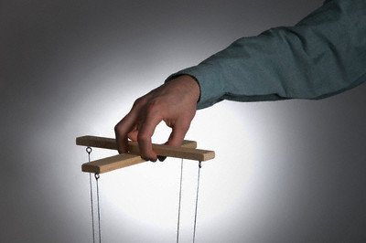
Manipulation vs. Assertiveness
An attempt to manipulate by:
Using ambiguous or deceptive communication
Manipulative communication creates a lack of trust
Example: “Don’t you really think it would be
better if we did it this way.”
Notes:
(Animated slide)
Option: Ask participants to share an example of when they have seen this control-approach used and to imagine more effective ways to approach the situation. Or, ask them to offer ways to rephrase the above example statement using supportive communication strategies.

Slide 13
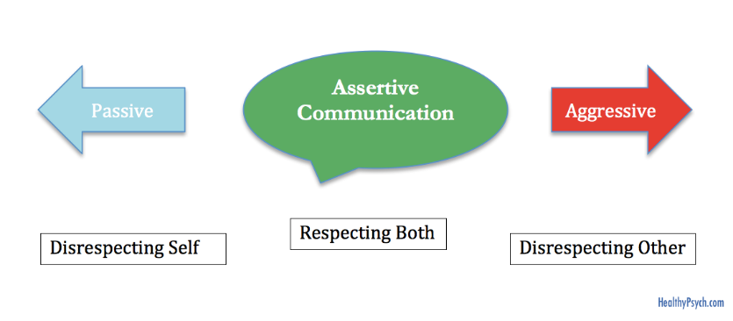
Manipulation vs. Assertiveness Assertiveness
Reacting honesty, openly and freely:
Hidden agendas that are not revealed openly interfere with collaborative practices
Direct communication without being aggressive
Example: “To feel comfortable that I can finish the
project in time, I really need that report by Friday.”
Notes:
(Animated slide)
Option: Ask participants to monitor their feelings when they say or hear the following statements: “Wouldn’t it be better if we did it this way . . . “ and “To feel comfortable that I can finish the project in time, I really need that report by Friday.”

Slide 14
Indifference vs. Empathy
Little to no regard for the feelings or welfare of another:
Communication that indicates a lack of warmth, caring and rejection
Disconfirming messages convey a lack of concern
Example: “We don’t have time to
hear about your concerns;
we have work to do.”
Notes:
(Animated slide)
Option: Ask participants to share an example of when they have seen this control-approach used and to imagine more effective ways to approach the situation. Or, ask them to offer ways to rephrase the above example statement using supportive communication strategies.

Slide 15
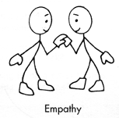
Manipulation vs. Assertiveness Empathy
Communication that demonstrates care and concern for others:
Requires that we try to see from the perspective of another
Requires that we listen for and acknowledge the other person’s needs, desires and feelings
Example: “That’s a difficult situation.
How can we help?”
Notes:
(Animated slide)
Option: Ask participants to monitor their feelings when they say or hear the following statements: “We don’t have time to hear about your concerns; we have work to do” and “That’s a difficult situation. How can we help?”

Slide 16
Superiority vs. Equality
Communication that maximizes power differences.
Communication that indicates superiority in things such as position, power, wealth, expertise, intellectual or physical abilities
Communication designed to get the upper hand
Example: “I am the chair of this committee
and I just explained to you how to do the
job correctly.”
Notes:
(Animated slide)
Option: Ask participants to share an example of when they have seen this control-approach used and to imagine more effective ways to approach the situation. Or, ask them to offer ways to rephrase the above example statement using supportive communication strategies.

Slide 17
Superiority vs. Equality Equality
Communication that minimizes power differences.
Communication that indicates that every member of the team is valuable
Everyone is given an equal opportunity
Recognition that everyone has strengths and limitations
Example: “I know I am the chair, but the
decision belongs to the whole committee.”
Notes:
(Animated slide)
Option: Ask participants to monitor their feelings when they say or hear the following statements: “I am the chair of this committee and I just explained to you how to do the job correctly” and “I know I am the chair, but the decision belongs to the whole committee.”

Slide 18
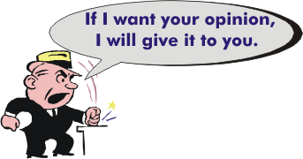
Certainty vs. Provisionalism
Dogmatic communication that indicates no debate is warranted.
Communication designed to win an argument rather than solve a problem
Communication designed to resist hearing different perspectives
Example: “You are wrong.
I know exactly what needs to be done.”
Notes:
(Animated slide)
Option: Ask participants to share an example of when they have seen this control-approach used and to imagine more effective ways to approach the situation. Or, ask them to offer ways to rephrase the above example statement using supportive communication strategies.

Slide 19
Certainty vs. Provisionalism Provisionalism
Communication that approaches problems as interesting issues and not power struggles.
Be open to consider other opinions fairly
Be tentative in expressing your opinion
Use qualifying terms (possibly, perhaps, maybe)
Example: “We may have difficulty finishing this
project on time unless we organize our efforts.”
Notes:
(Animated slide)
Option: Ask participants to monitor their feelings when they say or hear the following statements: “You are wrong. I know exactly what needs to be done” and “We may have difficulty finishing this project on time unless we organize our efforts.”

Slide 20
Using “I” Language Activity
Write down a “you” language statement for a problematic situation they are currently facing (or a situation you can imagine).
I-messages or I-statements communicate about a problem without accusing someone of being the cause of the problem.
“You” statement: "Hey, where's that report you were supposed to submit last Friday? You are holding up the whole project!”
Disguised “I” statement: “I feel stressed when you hold up the project by not completing reports in a timely manner.”
Notes:
(See detailed procedures on page 8 of the Trainer Manual.)
(Animated slide)
Provide the participants with a copy of the “Defensive and Supportive Communication Patterns” (handout page 9 of the Trainer Instructor Manual). After they have written their “you” statement, explain the difference between an effective “I” statement and a disguised “I” statement. Then ask participants to identify which type of defensive communication their “you” statement most closely represents (display the next slide).
Goal: To demonstrate that replacing a defensive communication pattern with supportive communication leads to more effective working relationships.
Materials Needed
“Defensive and Supportive Communication Patterns” Handout
PowerPoint slides 20-24
Procedures:
Have participants think about or imagine a problematic situation.
Ask participants to write their own “you” statement for this problematic situation (slide 20).
Explain that some “I” statements are really disguised “you” statements (slide 20).
Explain the importance of learning how to effectively use “I” language (slide 21).
Distribute the “Defensive and Supportive Communication Patterns” handout (page 9) and ask the participants to identify which defensive pattern most closely represents the “you” statement previously written (slide 20).
Review the WIIFM (slide 21).
Review the example of an “I” statement and a “you” statement (slide 23).
Walk participants through how to write an effective “I” statement (slide 24).
Divide the participants into groups of 3 and ask them to work together to transform their “you” statements into “I” statements.

Slide 21
How to effectively use “I” language
WIIFM: What’s In It For Me?
Open, timely, and respectful communication is an essential element of collaborative healthcare practice
Healthcare providers develop a deeper understanding of each other’s roles and responsibilities when respect and trust between team members is high
Awareness of each member’s contribution to patient care is essential in the delivery of quality care
Notes:
Remind participants how important the use of “I” language is in developing and maintaining effective interprofessional relationships.

Slide 22
Effective collaborative practice thrives in supportive communication
DEFENSIVE
SUPPORTIVE
Evaluation
VS
Description
Control
Problem Orientation
VS
Manipulation
Assertiveness
Indifference
Empathy
VS
Superiority
Equality
VS
Certainty
VS
Provisionalism
Notes:
Remind participants that “confront to heal, not hurt” is the basis of supportive communication and is necessary to maintaining high functioning inter-professional relationships that lead to quality patient care. Explain that each of the defensive and supportive patterns of communication was reviewed in previous slides.

Slide 23
USING “I” LANGUAGE
An “I” statement is a conversation starter and not the resolution.
“You” statement: "Hey, where's that report you were supposed to submit last Friday? You are holding up the whole project!“
vs
“I” statement: "I am getting stressed because I don't have that report yet. Do you know when it will be done? My report is due Friday."
Notes:
The use of supportive “I” language allows you to express how you are feeling and to provide information without making the other person feel as though s/he is being judged or evaluated.

Slide 24
USING “I” LANGUAGE
I-messages or I-statements communicate a problem without accusing someone of being the cause of the problem.
Change your “you” statement to an “I” statement
“Hey, I am getting backed up and feeling a little
stressed because I don't have that report yet.
I really need the report by Friday.”
When ____ (identify behavior prompting your feelings)
I feel ______ (identify how the behavior affects you)
I need ________ (state what you need to happen)
Notes:
Option: Have participants create one or more statements.

Slide 25
Large Group Report Out
Notes:
Option: What is the most significant take-away from this training? Or, if you could share one thing you learned today with a colleague, what would it be?

Slide 26
Thank you!
Questions?
Comments?

