Slide 1
Hi-Touch Healthcare
Notes:
Display as participants enter and explain that this training was developed and created based on industry and educator input in conjunction with the Health Workforce Initiative Statewide Advisory Committee, California Community Colleges Chancellor’s Office, and Workforce and Economic Development Program. This is just one soft skills module of the comprehensive training package: “Hi-Touch Healthcare: The Critical 6 Soft Skills.”

Slide 2
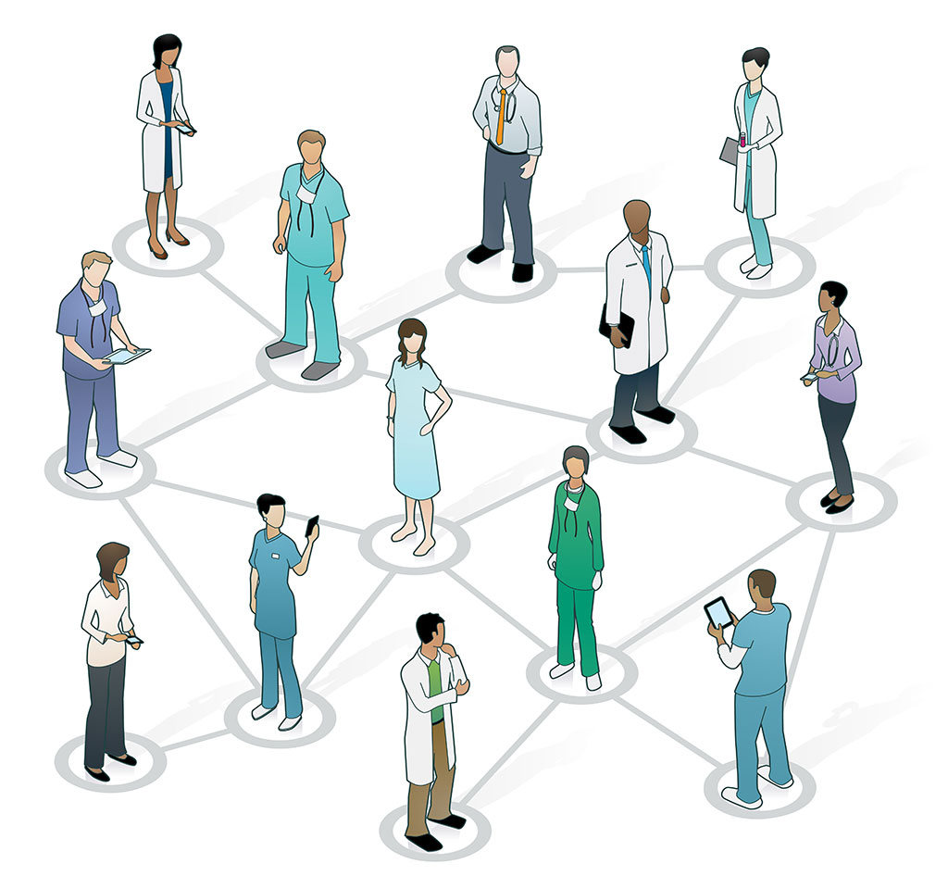
Stress Management and Self-Care

Slide 3
WHAT TO EXPECT IN THIS PRESENTATION
Impact of Stress of Employee Performance and Satisfaction
Life Stress Activity
Stress Worksheet
Pair/Share Activity
Compassion Fatigue Self-Test
Notes:
Quickly preview the session.

Slide 4
“The expectation that we can be immersed in suffering and loss daily and not be touched by it is as unrealistic as expecting to be able to walk through the water without getting wet.”
~ Remen
Notes:
Read quote by author Rachel Naomi Remen. Explain that this presentation will discuss stress in the healthcare environment and ways to deal with that stress.

Slide 5
Stress: Life’s Storms (Oginska-Bulik, 2006)
Stress is a naturally occurring phenomenon in the life of a nurse
Stress is like a storm — anything from a quick cloudburst to a hurricane. Like storms, stress follows a predictable life cycle
Prepare for life’s storm
Build your support network
Practice self-care
Study stress management strategies
During the storm, use your resources, implement your survival skills, and ask for support
After the storm, survey the damage, recover, and prepare for the next storm. Building a strong support system is the key to deal with stress in healthcare.
Notes:
Example: Bonnie is a staff nurse working on a busy medical-surgical floor. After arriving at work this morning, she learned that she would be in charge and that one of the nurses had called in sick. Another nurse on the unit snapped at Bonnie, “I am tired of working short, what are you going to do about it?” Bonnie immediately implemented her conflict resolution and time management skills. Next, she called the nursing supervisor and asked for help. Bonnie effectively managed “the stress of the day.” After work, Bonnie was able to “let go” of her stress—she went to her yoga class and soaked in a warm bubble bath.

Slide 6
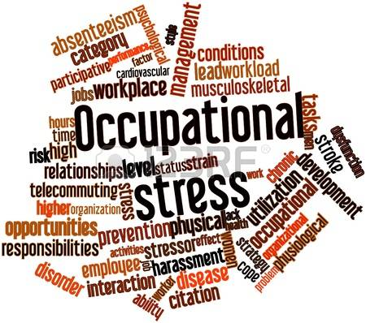
Occupational Stress
“The harmful physical and emotional responses that occur when the requirements of the job do not match the capabilities, resources, or needs of the worker.”
Notes:
The National Institute for Occupational Safety and Health (NIOSH), (2016) defines occupational stress as … (read definition.)

Slide 7
Occupational Stressors
The following workplace factors (job stressors) can result in stress:
Job or task demands
Organizational factors
Financial and economic factors
Conflict between work and family roles and responsibilities
Training and career development issues
Poor organizational climate
(Oginska-Bulik, 2006)
Notes:
The following workplace factors can result in stress:
Job or task demands such as work overload, lack of task control, role ambiguity
Organizational factors - for example, poor interpersonal relations or unfair management practices
Financial and economic factors of the organization
Conflict between work and family roles and responsibilities – for example, responsibilities at home interfering with work
Training and career development issues causing a lack of opportunity for growth or promotion
Poor working conditions such as inconsistent demands or expectations, poor staffing decisions, ineffective managerial styles, lack of support staff…but especially due to a lack of management commitment to core values or conflicting communication styles

Slide 8
Occupational Stressors (Oginska-Bulik, 2006)
Additional health care worker stressors:
Long work hours
Shift work
Customer service
Exposure to infectious and hazardous substances
Notes:
Additional stressors may include:
Long work hours - 12 hours shift vs. 8 hour shifts. Some institutions are going back to eight hour shifts.
Shift work - night shift, rotating shifts
Customer Service - balancing the needs of the patient, visitors, and organization
Exposure to infectious and hazardous substances (meningitis, Ebola…….)

Slide 9
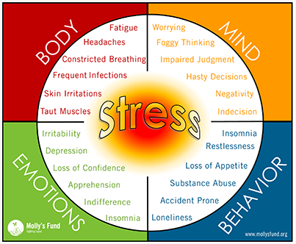
Impact of Stress on the Body (Oginska-Bulik, 2006)
Health
Relationships
Self-image
Quality of life
Coping
Notes:
Stress may be associated with the following types of reactions:
Impaired health (headache, upset stomach, changes in blood pressure…the list goes on)
Impaired relationships with supervisors and friends and family causing absenteeism from work and personal events
Impaired self-image
Decreased quality of life causing depression or sleep problems
Decreased coping, irritability, and inability to handle change

Slide 10
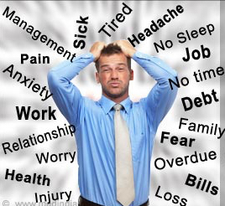
What are your Stressors?
Work
School
Home
Finances
Future
Past
Notes:
(Animated slide)
Think about your current your stressors. What is the first one that came to mind?

Slide 11
Activity #1 Life Stress Activity
Notes:
(See detailed procedures on page 5 of the Trainer Manual that accompanies this PowerPoint.)
Goal: This activity provides an opportunity for participants to discover various stressors they may currently have in life that may impact their ability to function at an optimal level at work.
Materials Needed:
One “Stress” Worksheet for each participant (on pages 6-7 of the Trainer Manual)
One “Life Stress Score” Results Sheet for each participant (on page 8 of the Trainer Manual)
Pen or pencil for each participant
Calculators for participant use (Optional)
Procedures:
Hand out a pen/pencil and one copy of the “Stress” worksheet to each participant.
Instruct participants to read the directions on the top of the worksheet and complete it to the best of their ability. Allow 15 minutes to complete the worksheet.
When everyone has completed the worksheet, bring the group back together and explain that the scale shows the kind of life pressure that you are facing at this time in your life. Depending on your coping skills, this scale can predict the likelihood that you will fall victim to a stress-related illness. The illness could be mild -- frequent tension headaches, acid indigestion, and loss of sleep to very serious illness such as ulcers, cancer, and migraine headaches.
Pass out the “Life Stress Score” results sheet to each participant.
Have the participants compare their score with the key on the results sheet.
Were there things that surprised you about the list? Did you realize you had that many stressors in the last 24 months?
Ask them “So… what is your level of stress currently?”
(The next several slides will address ways stress can affect you as well as ways to deal with stress in your life.)

Slide 12
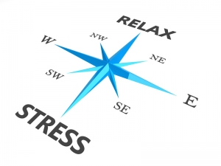
Activity #2 Pair/Share Activity
Think about a recent time when you were stressed (one at work and one at home) and you found a way to manage your reaction and feelings.
PAIRS: Take turns finishing the following statement:
“One of the best things I can do for myself when I am feeling stressed at work/home is…..”
SHARE: Be prepared to share with the large group.
Notes:
(Animated slide)
(See detailed procedures on page 9 of the Trainer Manual that accompanies this PowerPoint.)
Goal: This activity provides an opportunity for participants to share with each other ways that they deal with stress in their personal life and in their life at home.
Procedures:
Have participants think about a recent time when they were stressed—a situation at work and a situation. How did you manage your reaction and feelings to these situations? What strategies worked?
Pair: Have participants pair up.
Have them turn to their partner and take turns finishing the following sentence: “One of the best things I can do for myself when I am feeling stressed at work/home is _________.”
Share: have pairs share their responses with the large group, either having one partner report about the other or having one spokesperson report for the pair.
Discussion points:
Which ideas about coping with stress did you find new and/or helpful?
Which ideas were potentially harmful or destructive ways of dealing with stress (alcohol, drugs, etc…)? How do we know when these strategies and helpful and when these strategies become problems in themselves?
Which ideas will you try in the future?

Slide 13
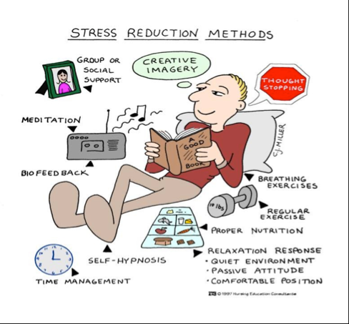
Response/answer to stress?
Isolation
Eating
Exercising
Alcohol
Pampering
Reading
Television
Friends/Family
Music
Notes:
Think about one of the stressors that you checked in response to the question: how do you usually deal with that stress?
What might be a better way to answer that stress response?
(Invite participants to share their stressors and ways they deal with them if desired.)

Slide 14
Definition of Self Care (Portnoy, 2013)
“Self-care is the intentional time taken to nurture yourself physically, mentally, spiritually, and emotionally on a daily basis.”
Notes:
How do we take care of ourselves?
Self Care Begins With You: (read the definition on slide)
Enhance your awareness with education.
Accept where you are on your path at all times.
Exchange information and feelings with people who you can talk with and get feedback from.
Clarify your personal boundaries. What works for you; what doesn't?
Verbally express your needs.

Slide 15
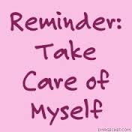
Practicing Self Care (Portnoy, 2013)
Have a more realistic perspective of yourself
Be more creative in dealing with challenges
Create a positive environment
Have self-confidence
Live in balance
Increase health and vibrancy
Be satisfied in your career
Have b etter coping skills
Notes:
When you begin to practice self care, you need to have realistic perspective of yourself. Be kind to yourself.
Accept where you are on your path at all times.
Understand that those close to you may not be there when you need them most.
Listen to others who are suffering.
Express your needs verbally.
Self Care will let you:
Have a more realistic perspective of yourself
Have a more realistic perspective of yourself
Be more creative in dealing with challenges
Create a positive environment
Have self-confidence
Live in balance
Increase health and vibrancy
Be satisfied in your career
Have better coping skills

Slide 16
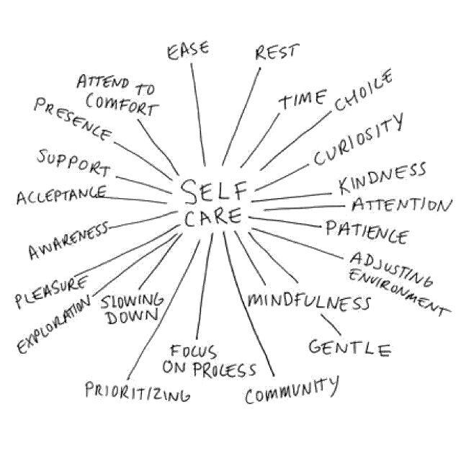
Decreasing Stress with Your Mind (Glasberg, Eriksson & Norberg, 2007)
Notes:
Discuss possible ways of dealing with stress that may occur at work:
Daily planner – makes organization and prioritization easier throughout the day
Journaling – write down how you feel when you have had a stressful day and what you did about your stress
Only make promises you can keep – creates realistic expectations because when expectations are not met, anxiety and stress results
Open communication with patients and staff – be honest and open
Think before speaking and reacting – take a “time out” before you speak. Plan what you’re going to say.
Breathing exercises – practice deep breathing ten times before reacting to a stressful situation.
Meditation – practice meditation if that helps reduce your stress.
Trust your inner wisdom and intuition – your “gut feeling” is very important, and usually right!

Slide 17
Compassion Fatigue-A Barren Desert (Portnoy, 2013)
Some healthcare providers feel that compassion fatigue can feel like being lost alone in a barren desert
Fighting for your survival can drain your depleted energy and scarce resources
Also known as secondary post-traumatic stress disorder
Emotional, physical, and spiritual exhaustion
Affects caring, self-sacrificing individuals prone to neglecting their self-care
Recovery from compassion fatigue is complex and individualized
Notes:
Some healthcare providers feel that compassion fatigue can feel like being lost alone in a barren desert (Portnoy, 2013).
Fighting for your survival can drain your depleted energy and scarce resources. You need help and hope as you find your way through the desert.
Compassion fatigue, also known as secondary post-traumatic stress disorder, is defined as the emotional, physical, and spiritual exhaustion from witnessing and absorbing the problems and suffering of patients in our institutions. The symptoms of compassion fatigue include despair, hopelessness, numbing, apathy, cynicism, anxiety, depression, sleep disturbances, physical complaints, decreased work performance and exhaustion.
Recovery from compassion fatigue is complex and individualized. If you suspect you may be suffering from compassion fatigue, please tell those closest to you and consult your health care practitioner or a mental health professional.
Example - Monique is having trouble getting out of bed in the morning — she feels severely fatigued and depressed. Monique desperately tries to hide her symptoms at work. She doesn’t know how she will “make it through another day.” Monique has been a nurse for more than twenty years. In that time, she has consistently put the needs of others before her own needs. Caring for her terminally ill mother naturally fell on her shoulders as “the nurse in the family.” Lately, Monique’s symptoms have become unmanageable and undeniable.
Monique’s recovery began by overcoming her denial. After seeking the support of a mental health counselor, she requested a family medical leave from her work. Her counselor is helping her to establish a self-care routine, set healthy boundaries, and to mobilize her resources. Monique asked her siblings to help care for her mother; together they have arranged for hospice care. Monique knows that her recovery will be a slow process but she no longer feels alone.
Whatever your status — transient stress, burnout, or compassion fatigue — there are countless strategies and resources available to you. We become stronger when we help our selves and each other.

Slide 18
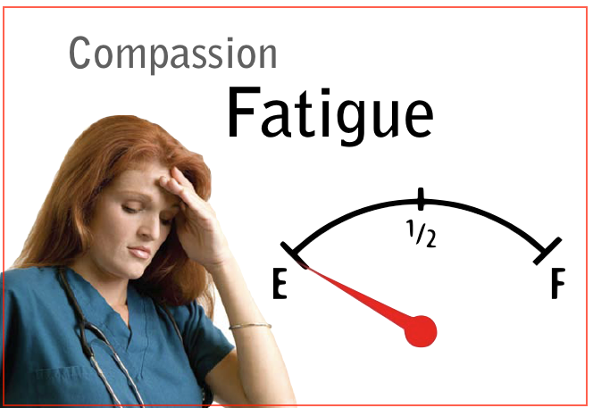
Compassion Fatigue Continued
Definition:
Indifference to those who are suffering, experienced as a result of the frequency or number of stressful exposures. As a result, workers may struggle to function in care giving environments. Eventually, negative attitudes prevail.
Notes:
What is Compassion Fatigue? Read definition.
Day in, day out, workers struggle to function in care giving environments that constantly present heart wrenching, emotional challenges.
Compassion Fatigue symptoms are normal displays of chronic stress resulting from the care giving work we choose to do. Leading traumatologist Eric Gentry suggests that people who are attracted to care giving often enter the field already compassion fatigued.
If you sense that you are suffering from compassion fatigue, chances are excellent that you are.
Your path to wellness begins with one small step: awareness.

Slide 19
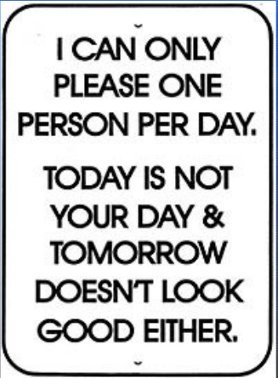
Symptoms of Compassion Fatigue (Portnoy, 2013)
Excessive blaming
Bottled up emotions
Isolation from others
Everyone complains to you
Complaints about them
Substance abuse
Compulsive behaviors
Notes:
Think about people that you work with, and yourself. Are you or they experiencing any of these symptoms?
Excessive blaming
Bottled up emotions
Isolation from others
Receives unusual amount of complaints from others
Voices excessive complaints about administrative functions
Substance abuse used to mask feelings
Compulsive behaviors such as overspending, overeating, gambling, sexual addictions

Slide 20
Symptoms of Compassion Fatigue
Legal problems
Nightmares and flashbacks to traumatic event
Chronic physical ailments
Recurrent colds
Apathy
Difficulty concentrating
Mentally and physically tired
Notes:
Legal problems, indebtedness
Reoccurrence of nightmares and flashbacks to traumatic event
Chronic physical ailments such as gastrointestinal problems and recurrent colds
Apathy, sadness, no longer finds activities pleasurable
Difficulty concentrating
Mentally and physically tired

Slide 21
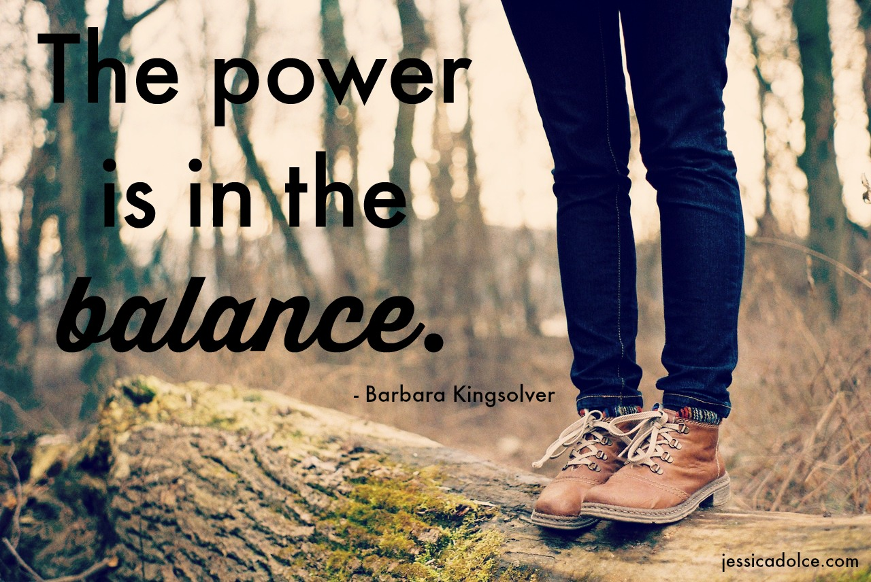
Activity #3 Compassion Fatigue Exercise (Compassion Fatigue Awareness Project, 2013)
Notes:
(See detailed procedures on page 10 of the Trainer Manual that accompanies this PowerPoint.)
Goal: This activity provides an opportunity for participants to explore their own compassion fatigue.
Materials Needed:
One “Compassion Fatigue Self-Test” for each participant (on pages 11-12 of the Trainer Manual).
Pen/pencil for each participant.
Procedures:
Pass out a “Compassion Fatigue Self-Test” and a pen/pencil to each participant.
Have them read the instructions on the self-test. Questions?
Give participants 5–7 minutes to complete the self-test.
Reflect: When everyone has completed the self-test, invite discussion about the following points:
Do you think you have compassion fatigue? Why or why not?
If so, can you think of some ways to prevent this from happening? If not, what current habits do you think help prevent this sort of fatigue?
Can you think of ways to deal with it once you realize you are experiencing it?

Slide 22
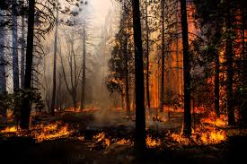
Burnout: Destructive Forest Fire (Portnoy, 2013)
The metaphor of a forest fire for burnout describes the destructive depletion of life-sustaining resources.
Burnout is the frustration, loss of interest, decreased productivity, and fatigue caused by overwork and prolonged stress.
The potential consequences of burnout are emotional distress, physical illness, and interpersonal conflict.
In the workplace, burnout leads to low morale, high absenteeism, high turnover rates, and occupational injuries.
Just as most forest fires are preventable, burnout is preventable.
Notes:
Compassion fatigue can lead to burnout. The metaphor of a forest fire for burnout describes the destructive depletion of life-sustaining resources.
Burnout is the frustration, loss of interest, decreased productivity, and fatigue caused by overwork and prolonged stress.
The potential consequences of burnout are emotional distress, physical illness, and interpersonal conflict. In the workplace, burnout leads to low morale, high absenteeism, high turnover rates, and occupational injuries.
Just as most forest fires are preventable, burnout is preventable. Protection and conservation of your precious resources is the key to burnout prevention. Your primary resources are your time and energy.
Example: Anthony is a critical care nurse. He has recently moved into his dream home with his wife Marie and their two children. Anthony began working extra shifts at another hospital six months ago to offset their moving expenses. Anthony spends most of his time off working on his endless to-do-list of home improvement projects. Marie is concerned — Anthony no longer has time for their regular “date night” or the energy to play with his children. Anthony’s nurse manager has noticed a decline in his attitude and the quality of his work. Anthony is burning out.
Anthony began working with a life coach. His initial goal was to “learn how to get more things done.” His coach guided Anthony as he modified his plan; Anthony’s new goal is creating work-life balance. Anthony began by clarifying his values and priorities. Next, he developed a sustainable self-care plan. Anthony has cut back to working occasional extra shifts and is developing a realistic timeline for his home improvement projects. In addition, he has resumed his “date nights” with Marie and regularly arranges “play dates” with his children. His nurse manager recently remarked, “I am happy to see the old Anthony back again.” He is confident that she will like “the new Anthony” even better.

Slide 23
Are you Experiencing Burnout?
Ask yourself these simple questions….
How often are you tired and lacking energy to go to work in the morning?
How often do you feel physically drained, as if your batteries were dead?
How often is your thinking process sluggish or your concentration impaired?
How often do you struggle to think over complex problems at work?
How often do you feel emotionally detached from coworkers or customers, and unable to respond to their needs?
Notes:
(Animated slide. Pause to discuss as needed.)
Read the slide. If you are experiencing burnout, compassion fatigue or stress at work or home, the hope is that this module will assist you with learning ways to deal with these issues and increase your enjoyment of life at work and at home.

Slide 24
Whatever your status — transient stress, burnout, or compassion fatigue — there are countless strategies and resources available to you. We become stronger when we help our selves and each other.
Notes:
Together we are stronger.

Slide 25
Thank you!
Questions?
Comments?

