Slide 1

Hi-Touch Healthcare
Notes:
Display as participants enter and explain that this training was developed and created based on industry and educator input in conjunction with the Health Workforce Initiative Statewide Advisory Committee, California Community Colleges Chancellor’s Office, and Workforce and Economic Development Program. This is just one soft skills module of the comprehensive training package: “Hi-Touch Healthcare: The Critical 6 Soft Skills.”

Slide 2

Time Management

Slide 3

What to Expect in this Presentation
Overview of job burnout
    Activity #1: Job Stressors Quiz
    Activity #2: Who? Me? Stressed? Role-Play
Addressing causes of burnout
    Activity #3: Planning Activity
    Activity #4: How Many Fit?
    Activity #5: We Got The Power!
Three powerful time management tips
    1) Say no
    2) Time chunking
    3) Hangman’s lesson
Notes:
Quickly preview the session.

Slide 4
job stressors QUIZ Activity
Answer is: 20 million
  Correct response: What is the number of newly insured since 2010 due to Affordable Care Act? (U.S Department of Health and Human Services, 2016)
Answer is: 29% increase
  Correct response: Percentage increase of primary care workload between 2005 -2025 without the ACA impact! (Schwartz, 2012)
Answer is: Most likely to suffer job burnout
  Correct response: Who are healthcare workers? (Jennings, 2008; Lyndon, 2016)
Answer is: Two trends adding to stress
  Correct response: What are technology and interprofessional collaboration ? (Mayo Clinic, 2016; Wachter, 2013).
Notes:
(Animated Slide—after the title, four “answers” will appear on the click, followed by each correct response in order.)
See detailed procedures on page 5 of the Trainer Manual that accompanies this PowerPoint.)
Goal: To acknowledge the link between external stressors and time management as one method of reducing negative impacts of stress.
Procedures:
(Note to trainer: Depending on the participant make-up of your groups, you may find value in adding the comments about burnout associated with nurse and physician professionals noted in the introduction to this training document.)
Reveal only the title of PowerPoint slide 4 until prompted.
Ask participants to form small groups of 3-4 people (or join pairs if few participants) and that one person is the designated “contestant.” When prompted, the contestant will provide the responses on behalf of the group.
Explain that groups are about to be shown four answers, similar to the game show Jeopardy. Groups will be given a few minutes to discuss and determine an answer. The contestant for each group will be called on to give the group’s response to each question.
Working with one question at a time, give all contestants a chance to answer before revealing the correct response. Once answer has been revealed, briefly discuss.
Debrief this slide by noting that not all stress is bad and that not everyone who encounters job stress will succumb to burnout. Mention other groups who encounter burnout such as police officers and teachers.
Conclude by explaining the reason this session on time management began with an activity about stress and burnout is because according to the CDC and others, one way to combat both is through effective time management practices.

Slide 5
Who? Me? stressed? activity
Complete the worksheet
Form groups of 3–4
Create your “stress-skit”
Enjoy the show!
Notes:
(See detailed procedures on pages 6–7 of the Trainer Manual that accompanies this PowerPoint.)
Goal: This activity encourages laughter in dealing with daily stressors because laughter is linked with both stress reduction and learning.
Materials Needed:
Copy of the “Who? Me? Stressed?” worksheet (on page 7 of the Trainer Manual)
Pen/pencil
Procedures:
(Note to trainer: Advise participants that this is an individual and small group activity.)
Distribute a copy of the worksheet to each participant. Each participant should independently review and complete the seven questions on the worksheet. (3–5 minutes.)
Have participants form groups of 3–4 people and briefly discuss their responses (for small number of participants in a session, this can be a partner activity).
Next, tell them they will have 10 minutes to create a “stress-skit” which is an overly dramatized (and humorous) role-play of a stressful situation that one or more has encountered. Encourage creativity, imagination, and suggest formats such as musicals (GREASE, Hamilton…) soap operas, or Shakespearean plays.
After 10 minutes (and they will probably want more), invite volunteers (or each group depending on the participant feedback) to perform their stress-skits in front of the large group.
(During the creation and delivery of the stress skits, there will be laughter!)
Conclude this activity by reminding participants of the many health benefits of laughter, including stress reduction. In addition, there are a number of studies supporting the link between laughing and learning.

Slide 6
What is burnout
(Mayo Clinic, 2015)
Definition
Some Causes
“Job burnout is a special type of job stress — a state of physical, emotional, or mental exhaustion combined with doubts about your competence and the value of your work”
Loss of control
Mismatch in values
Work-life balance
Unclear job expectations
Dysfunctional workplace dynamics
Notes:
(Animated Slide--reveal the definition and then each of the five causes of burnout.)
Explain that this time management workshop will define some of the causes of burnout according to Mayo Clinic and address methods of reducing their impacts. The next slide begins with “loss of control.”

Slide 7
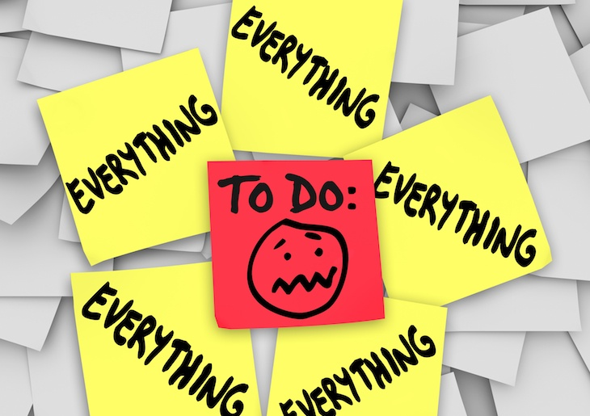
Lack of control
Notes:
Give a moment for everyone to review the image and then define the first cause.
Lack of control: An inability to influence decisions that affect your job — such as your schedule, assignments or workload, which could lead to job burnout. So could a lack of the resources you need to do your work. Clarify that we can’t control everything but we can control some areas. One step in taking control is to plan. The next slide begins an activity on how well we plan.

Slide 8
Planning activity: Side A
Partner up!
  Quickly review the planning descriptions on SIDE A of the handout ONLY.
    Discuss your planning style with your partner.
    Reveal effective and ineffective planning outcomes from recent history.
  Large group share.
Notes:
(See detailed procedures on pages 8–10 of the Trainer Manual that accompanies this PowerPoint.)
Goal: Participants will identify their planning style. This activity is designed to demonstrate that there is always room for growth.
Materials Needed:
PowerPoint slides 8–10
One copy of the “Planning Activity” worksheet (includes SIDE A and SIDE B) for every participant (on pages 11–12 of the Trainer Manual).
One copy of the “Planning: Interpretation, Scores & Next Steps” worksheet (on page 13 of the Trainer Manual).
Pen/pencil for each participant
Procedures:
(Note that this is a three-part activity. However, if reduction in activity time is needed, modify the procedure to create an individual activity and ask participants to only complete the survey and disregard the paired activities.)
Part One:
(Note to trainer: The first part of the activity invites participants to think about and engage in discussion about effective and ineffective planning efforts. This step sets the stage for part two of the activity which is SIDE B of the “Planning Activity” handout.)
Reveal PowerPoint slide 8. Explain that this activity provides opportunity to look at an area for reducing stress and to increase time-management effectiveness.
Inform the group that this is the first of a three-part activity and hand out one copy of the “Planning Activity” worksheet to each participant. Advise participants that the first part of the activity will use SIDE A of the worksheet.
Next, ask participants to find a partner (triads can also be used).
Read aloud the directions on the worksheet listed below:
Directions: With your partner, discuss your personal planning style and effective/ineffective planning outcomes from your recent history.
After, circle the label below that you believe is most representative of your planning style.
Instruct participants to quickly review the planning styles listed on SIDE A of the worksheet and, using that information as a guide, discuss with which planning style each identifies and why. Ask them to be specific and to use examples as rationale for their selection.
After a few minutes, invite volunteers to share.
Finally, ask participants to take their seats again. To begin part-two of the activity, transition to the next PowerPoint slide.

Slide 9
Planning activity: Side B
How well do you plan?
Please turn over the “Planning Activity” worksheet to SIDE B and complete it.
  Work independently and quietly.
  “If you don't know where you are going,
  you'll end up someplace else.”
  ― Yogi Berra
Notes:
Procedures Part Two:
Ask participants to turn over the Planning Activity worksheet to SIDE B (page 12 of the Trainer Manual) and, working independently and quietly, complete the survey.
After a few minutes verify that total scores are being documented.
As worksheets are completed and scores totaled, ask participants to turn over the worksheet to SIDE A and to sit quietly while everyone finishes.
To conclude the activity by completing part three, transition to the next PowerPoint slide revealing only the title.

Slide 10
Planning Scores & Next Steps
6-10: Terrible Planner | 11-15: Below average planner | 16-20: Average planner | 21-25: Above-average planner | 26-30: Excellent planner —or— candidate for burnout?
Start by taking a time management course. | Evaluate and adopt planning tools and effectiveness techniques. | It’s working. Focus on your priorities & daily plan. | Keep up the good work. Use periodic reviews to be sure you’re planning around what matters most in your life. | You have mastered planning. Make sure you’re in control of your planning rather than letting it control you.
“We can plan
to control what
we can!”
Notes:
(Animated Slide—stay on title until prompted.)
Procedures Part Three: Activity Conclusion
Before bringing up the chart on this slide which shows the scores and next steps, for credibility of the survey instrument as a valuable assessment, explain that this planning activity and quiz was adapted from the work of Hyrum Smith, time management and planning expert associated with Franklin Covey.
See frankincoveyspeakersbureau.com for additional information if desired.
Next, reveal the chart on the PowerPoint slide and review each planning style.
Remind participants of the first part of the activity and ask them to review their actual scores and planning style from SIDE B and then to return to SIDE A of the Planning Activity worksheet to compare what they circled on SIDE A to what their survey scores indicated.
Provide a copy of the “Planning: Interpretation, Scores & Next Steps”” worksheet (page 13 of the Trainer Manual) to each participant and ask them to review it independently.
Invite participants to share their experiences with the larger group as time allows.
Conclude the activity by emphasizing that while planning is an important function, becoming overly rigid with planning, not planning effectively, and/or focusing our time and energy on matters that do not align with our priorities can lead to stress and burnout. Emphasize that we can’t control everything but “we can plan to control what we can.” (Reveal this statement on the PowerPoint slide and invite participants to say it out loud.)

Slide 11

Mismatch in Values
& work-life balance
What is the use of running when we are on the wrong road?
  -Bavarian proverb
Notes:
Explain that the next causes of burnout being discussed (mismatch in values and work-life balance; although it might be better titled imbalance) relate to effective and ineffective planning because if one is not specifically aware of their priorities and values and aligning those with daily plans, these two causes are more to likely to create negative consequences for time management effectiveness. Describe the terms as indicated below:
Mismatch in values. If your values differ from the way your employer does business or handles grievances, the mismatch can eventually take a toll.
Work-life imbalance. If your work takes up so much of your time and effort that you don't have the energy to spend time with your family and friends, you might burn out quickly.
(This leads to the next activity.)

Slide 12

How many fit?
Notes:
(See detailed procedures on pages 14–15 of the Trainer Manual that accompanies this PowerPoint.)
Goal: To introduce principles for intentionality in thinking though the interplay among core values, planning, and time management in order to reduce two causes of burnout: mismatch in values and work-life balance.
Materials Needed:
PowerPoint slides 12–14
1 clear glass vase or jar large enough in size to be seen throughout the room but small enough to be manageable
Large rocks, small rocks (gravel or pea gravel), sand and water
The large rocks must be able to fit in the glass jar
The other rocks and water should be sufficient in quantity to fill the glass jar as detailed in the procedure
A box or covered tub to hide the objects until used in the procedure
Procedures:
(Note to trainer: It’s important to the outcome that the rocks, sand, and water remain out of site until prompted below.)
Put the glass container on a flat and sturdy surface, easily seen by all participants. Keep the other materials hidden. (It would be prudent to ask those participants who know the outcome to remain silent.)
As indicated on PowerPoint slide 12, state that there is a quiz. Bring out and show the participants, ONLY the large rocks and ask, “How many of these rocks will fit into this jar?” Ask them to quickly write down the number. Then say, “Let’s find out” and begin to put as many large rocks as you can into the glass container. Then ask, “Is the jar full?”
Most respondents will say “yes.” (Be aware if participants have seen this activity before they will say “no” ---remind folks to remain quiet if they know the outcome already.)
Next, take out the small rocks (gravel) and dump as much into the same container with the big rocks. Ask again, “Is it full?” Some will be wiser and respond “Maybe not” some will still say that it is full.
Take out the sand and repeat the above step. By now when asked “Is the jar full?” Respondents should reply, “NO!” Praise this response. Or, if they say think it is full, prompt with “Are you sure?” and then move to the next step.
Now take out the container of water and fill the jar until it is full. Then proclaim enthusiastically, “Now it’s full!” Then ask, “Can anyone explain the point of this quiz?” Because this is a time management presentation, the expected response will be: “You can always squeeze more into your day/schedule/life.” Respond by stating that is incorrect. Clarify, “The point of this illustration is to put the big rocks in first or they won’t fit.”
Transition to PowerPoint slide 13 and explain the Pareto Principle.

Slide 13
Moment of truth
“The key is not to prioritize what's on your schedule,
but to schedule your priorities.”
-Stephen Covey
Notes:
Read the Stephen Covey quotation aloud.
Explain Pareto's Principle (Pareto's Law) frequently called the 80/20 Rule means that in anything we do a few (20 percent) are vital and many (80 percent) are trivial. This principle applies to business (80% of the work is done by 20% of the people) and it’s critical in time management. In order to determine one’s “big rocks” in life, it’s important to understand this principle.
(The next slide continues and concludes the activity.)

Slide 14
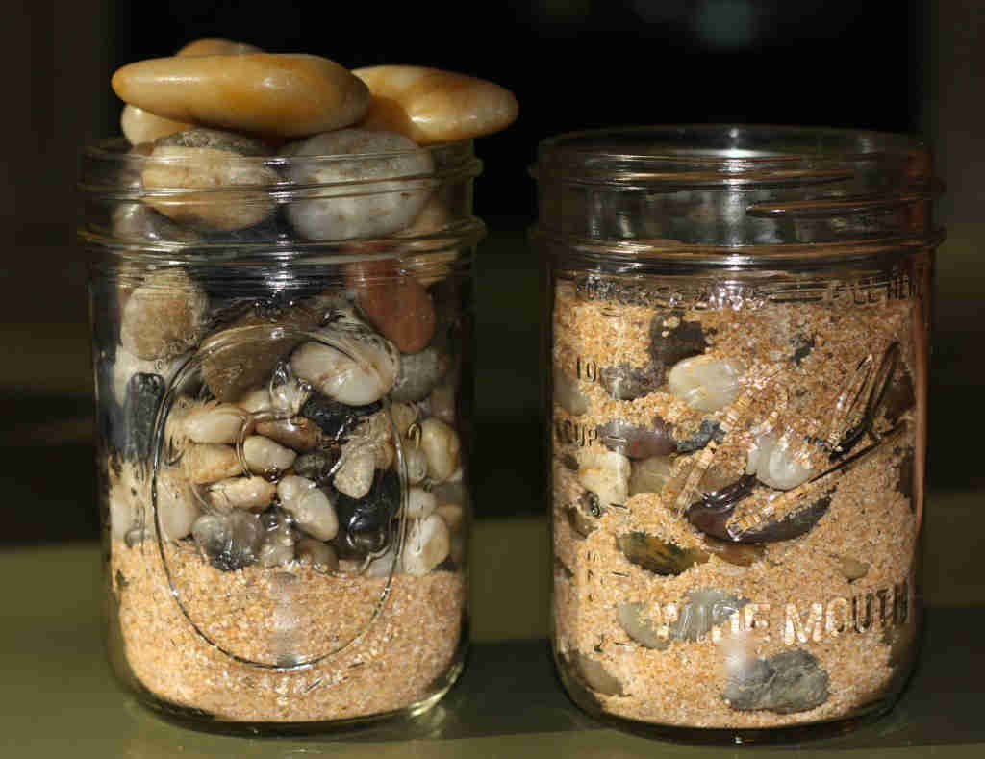
What are the big rocks in your life?
Time with your loved ones?
A musical instrument? Your favorite hobby?
Your faith, your education, your finances? A cause?
Remember to put these Big Rocks in first: Align your values, and practice at work-life balance.
Notes:
1) Read the idea prompts aloud on this slide and ask participants to make a list of their own “big rocks.” After a few minutes invite volunteers to share with the group.
2) Conclude by explaining that this activity introduced principles for being intentional in thinking through core values and what is most important. When we put this perspective into practice so that our plans and schedules align with our values and what matters most in life, we are reducing the effects of the two causes of burnout that started this activity: Mismatch in values and work-life balance.

Slide 15
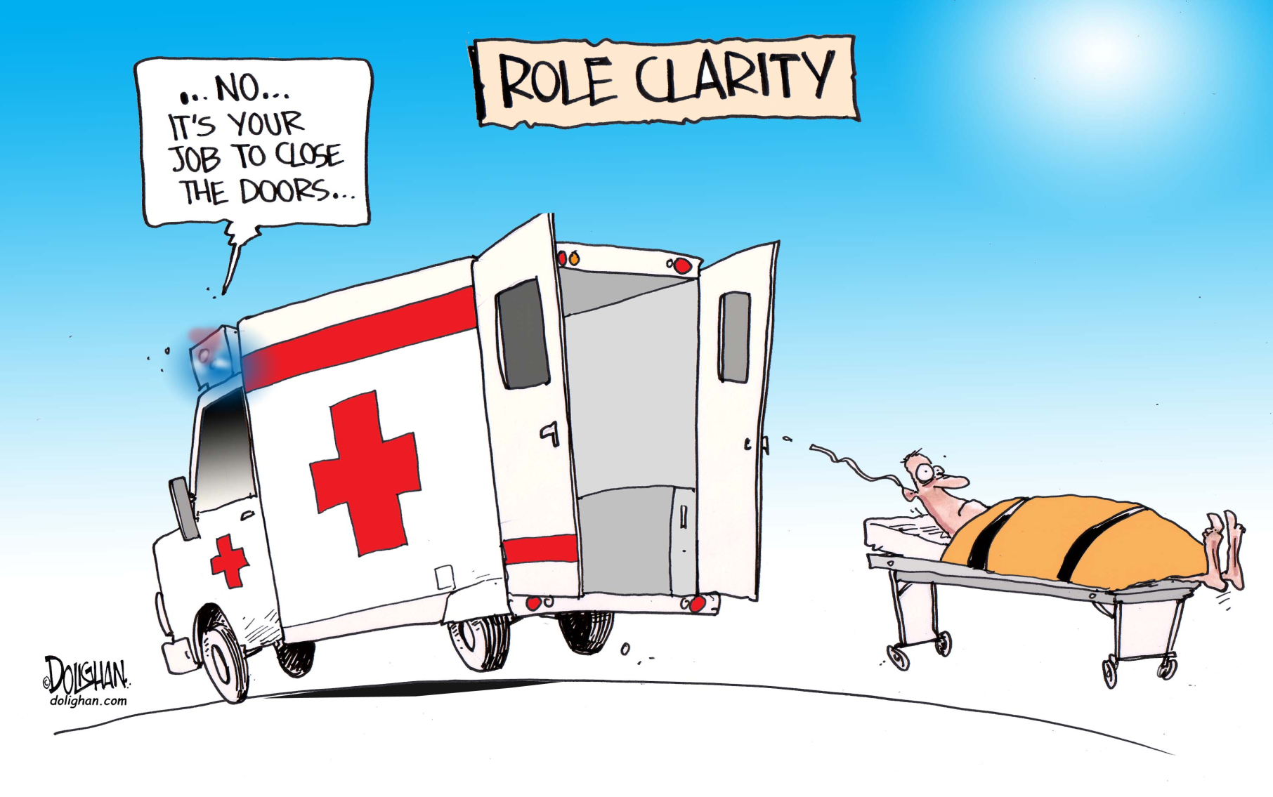
Workplace communication
Dysfunctional workplace dynamics
“Unclear job expectations
Notes:
(Animated slide—briefly review the humorous image and then reveal the next two causes of burnout described below.)
“Unclear job expectations. If you're unclear about the degree of authority you have or what your supervisor or others expect from you, you're not likely to feel comfortable at work.
Dysfunctional workplace dynamics. Perhaps you work with an office bully, or you feel undermined by colleagues or your boss micromanages your work. This can contribute to job stress.”
After describing these two causes, first observe that in the interprofessional collaborative environment these two causes are now likely more prevalent than ever. Explain that one way to reduce the stress of these two workplace challenges is with improved communication. The next slide begins with background knowledge of interpersonal communication power dynamics and introduces an activity designed to increase workplace communication effectiveness and, as a result, reduce stress when dealing with unclear job expectations and dysfunctional workplace dynamics.

Slide 16
We got the power:
Relational communication
A one-up message:
  Expresses dominance and takes the form of a command.
  EX: “Enter that patient data.”
A one-down message:
  Communicates submission or acceptance of the other person’s decision-making ability.
  Statement EX: “Wherever you think we should move the gurney is fine with me.”
  Questions EX “Where would you like to have the gurney moved?”
A one-across message:
  Conveys neutrality in the relationship.
  Factual statements EX: “There are many brands of scrubs to choose from.”
(Floyd, 2017)
Notes:
(Animated Slide—Remain on the title slide until prompted below and then reveal each power style one at a time and explain each one.)
(Trainer: See detailed procedures on pages 16–17 of the Trainer Manual that accompanies this PowerPoint.)
Goal: To provide demonstration and practice of controlled responses to varied communication situations.
Materials needed:
PowerPoint slides 15–17
Procedures:
Stay on the title of PowerPoint slide 16 until prompted. This slide introduces the background knowledge needed to continue to the activity.
Explain some of the complications occurring in today’s healthcare environment with regard to complexities including increased use of technology and greater demand for teams to work effectively. These complexities add stress and strain on everyone. Unclear job expectations and dysfunctional workplace dynamics are on the rise due to the rapid pace of change in healthcare. Even if one doesn’t consider “power” in their interpersonal communications at work, according to interpersonal communication scholar, Kory Floyd (2017), power is consistently present in any relationship. Sometimes the dynamics are equal but usually one person has more power than another.
There are three specific types of verbal messages we use and power dynamics influence them all. Explain that the term “verbal” means it might be written (i.e. emails, texts) or it might be spoken (i.e. telephone or face to face). The three types of verbal messages are:
A one-up message expresses dominance and takes the form of a command. Such as, “Enter that patient data.”
A one-down message communicates submission or acceptance of the other person’s decision making ability. This is expressed in statements like, “Wherever you think we should move the gurney is fine with me.” Or these messages might be in the form of a question, such as, “Where would you like to have the gurney moved?”
A one-across message conveys neutrality in the relationship. These are expressed in the form of factual statements, such as, “There are many brands of scrubs to choose from.”
Transition to the next slide to begin the activity.

Slide 17
We got the power: communication activity
Partner up!
Decide on a situation such as “cleaning up a code brown” or “transporting a patient”
Practice via role-play the three verbal relational communication styles
  1) One-up: dominant uses command
  2) One-down: submissive uses question or statement
  3) One-across: neutral uses statements of fact
Notes:
(The activity on the this slide introduces one way to help intentionally frame our verbal messages (written and spoken) to match one of the three power styles introduced on the previous slide.)
First review the slide then ask participants to begin the role-play.
Conclude by reminding participants that we can’t control everything but we can control how we respond. We demonstrate our control with how we communicate our responses. Have the large group respond to these prompts:
When is each type of power style most effective or least effective?
How will this type of communication know-how positively impact working relationships?
How might this reduce some work related stress associated with unclear job expectations and dysfunctional workplace dynamics?
What does this have to do with time management? (Trainer: if participants don’t get the point about solving some of the causes that lead to job burnout which then impacts time management and vice-a-versa, below is a list of consequences of burnout according to the Mayo Clinic website.)
Excessive stress
Fatigue
Insomnia
A negative spillover into personal relationships or home life
Depression
Anxiety
Alcohol or substance abuse
Heart disease
High cholesterol
Type 2 diabetes, especially in women
Stroke
Obesity
Vulnerability to illnesses

Slide 18
time management tip: everyone needs to “no.”
Learn to say “no.”
  Ask yourself these four questions:
    1) Am I really and truly into this?
    2) Does it align with my “big rocks?”
    3) Do I have time in my schedule or can I drop something else from my schedule?
    4) Am I simply seeking approval?
Notes:
One of the consistent tips for all people when it comes to time management is learning to say “no.” We say yes and sometimes find we are overcommitted, regret helping, or simply don’t want to do whatever we agreed to do. These questions don’t explain how to communicate the word “no,” but they provide a guide to make an informed choice of response. (The strategy on the next page helps is helpful trick to learn.)

Slide 19
Before you say anything
Say “DU”
DE-CATASTROPHIZE
(de-cat-a-straw-fize)
UN-EMOTIONALIZE
(un-emo-shun-a-lize)
Notes:
(Animated Slide)
Although somewhat silly, this “mantra” of “DU” (pronounce duh) is helpful in learning WHEN to say no. Explain that the ideas behind the words as noted below. Just for fun, invite participants to say each aloud.
De-catastrophize: Take the “doom” out of the equation. What is really the worst thing that will happen if you honestly say, “No.”
Un-emotionalize: Remove the ego. Yes, it’s nice to be asked, invited, called upon. But, if you remove your ego from the equation and think about your priorities, saying no becomes a lot easier.
(Trainer note: Essentially these two words have been made-up to make this point.) The next slide gives tips for how to actually say the word, “no,” in a constructive way.

Slide 20
No by Joe
No with empathy – “It sounds like this is an important project. I wish I could take that on, but our team’s plate is full right now with other high priority items.”
Not now but later – “We are booked solid through next week with other high priority tasks. Would the following week still meet your timeframe?”
No, unless… – “We would need to shift our current priorities and resources to take this on right now. Would you prioritize this above [Project B]? If so, are you ok if we delay [Project B] to make room for this?” Or “do we need to increase our budget to bring in more resources to handle this?”
No, but maybe someone else? “Do you think So-and-So’s team could help with this?”
  (Baker, 2013)
Notes:
Note that these tips on how to effectively say “no” are according to Joe Baker, a leadership consultant and executive coach. He explains: “How can you say 'no' effectively? Knowing when to say 'no' is about leading yourself and managing your schedule. Saying 'no' in a constructive way is about leading others and managing relationships.” Inc.com has a list of seven ways to say no and their list begins with “Say it.” I’s a small but powerful word. Remember to offer two other powerful words: Please and thank you, as the situation calls for. For example, “Thank you for inviting me. I can’t attend but please keep me in mind for next time.”

Slide 21
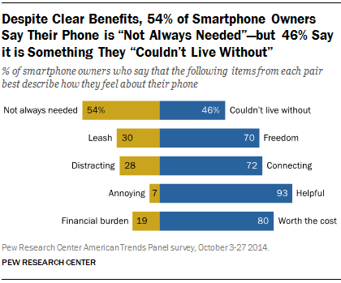
Time chunking
Notes:
One way to prioritize time mindfully rather than by responding mindlessly on “auto-pilot” to every message and electronic communication one receives is to set aside chunks of time. Set aside time in the morning, mid-day, and later to check and respond to electronic communication.

Slide 22
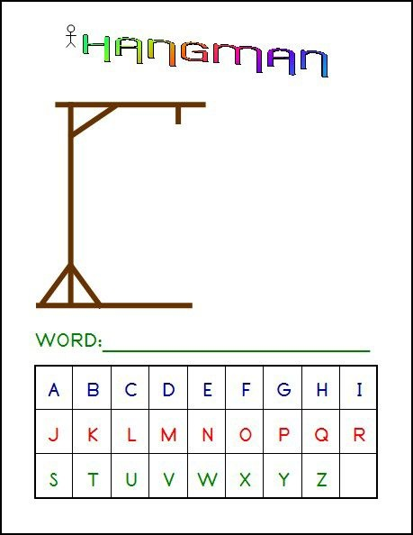
__ __ __ __ __ __ __ __ __ __
DEMOCRATIC
Notes:
(Animated Slide—stay on puzzle image until after solving for the correct word and then click to reveal it. Conclude the training session by playing this game of “hangman.” After it’s been solved, state that one cannot manage time. Time is not managed—but treats us all the same. It is democratic.)
Remind participants the overarching reality for healthcare employees: More work, fewer workers, but the same twenty-four hours each day. Use it wisely.

Slide 23
Thank you!
Questions?
Comments?
Notes:
If time allows, ask participants to review their “take-a-way” and how they will incorporate something they learned in today’s workshop.

